Slide 1

Esports
BY:
Mr. Rutik, Kothwala
Mr. Somil, Saparia
Mr. Nagul Meera, Shaik

Slide 2

Table of contents
Background
Problem Statement
Data Model
Creating Nodes
Relations Between Nodes
Loops in Graph
Removing NULL Value Nodes
Aggregation Functions
Querying the Database
Conclusion

Slide 3
Background
The e-sports industry has been experiencing rapid growth, with a vast amount of data generated from players, teams, games, genres, and their interrelationships. Analyzing and extracting insights from this complex data landscape is crucial for various stakeholders, including e-sports organizations, researchers, and enthusiasts. However, traditional relational databases struggle to efficiently represent and query the interconnected nature of e-sports data, hindering effective data analysis and decision-making processes.

Slide 4

Problem statement
The aim of this project is to analyzing e-sports data in a comprehensive and efficient manner with the use of a graph database, such as Neo4j, presents a promising solution. However, there is a need to develop a systematic approach to construct and manage the graph database schema, load data from various sources, and establish relationships between different entities to enable meaningful analysis and exploration of e-sports data.

Slide 5
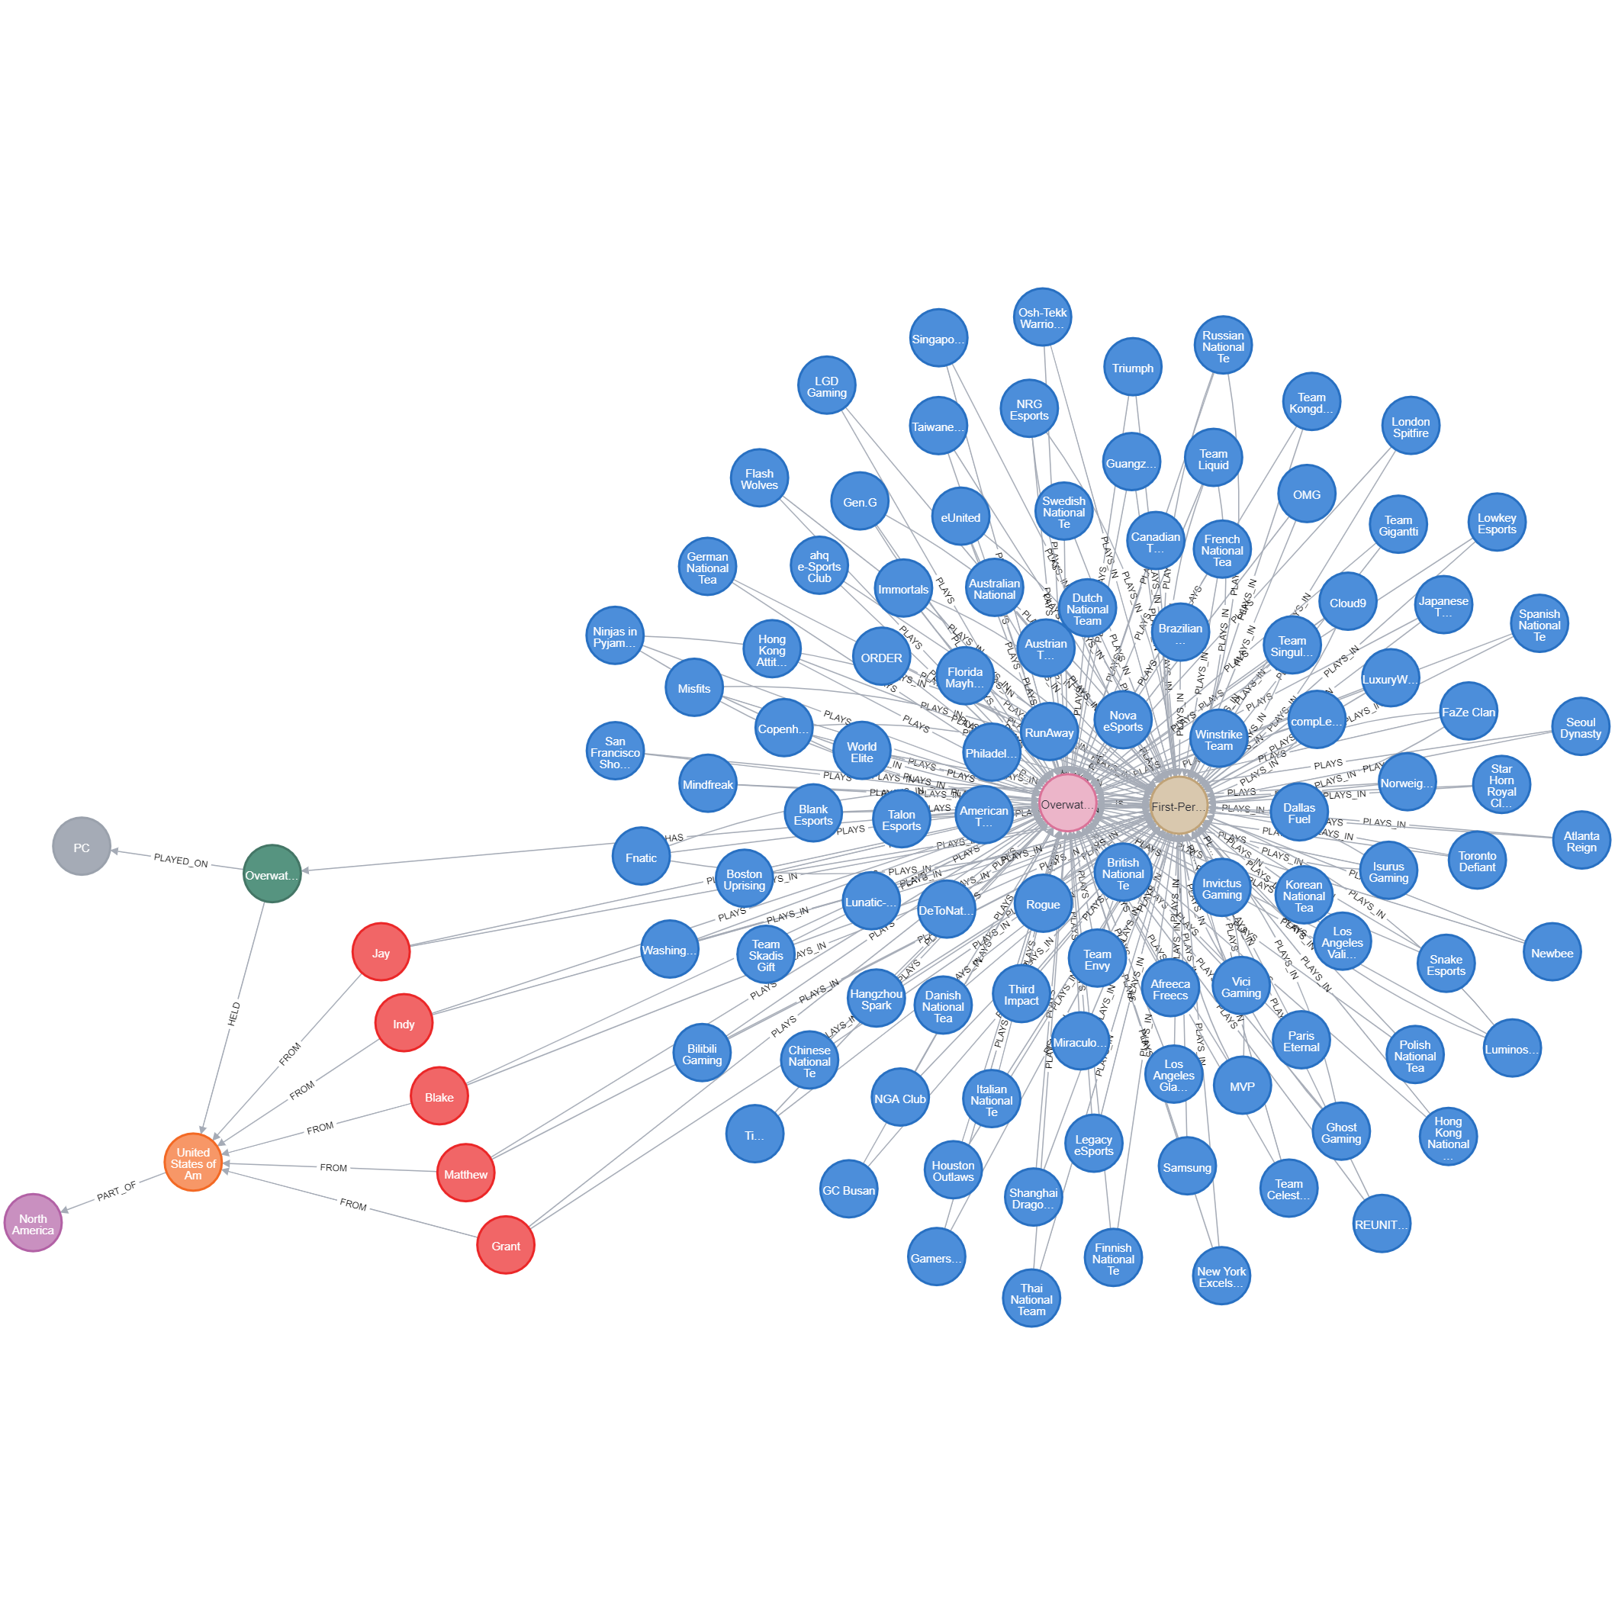
Data Model

Slide 6
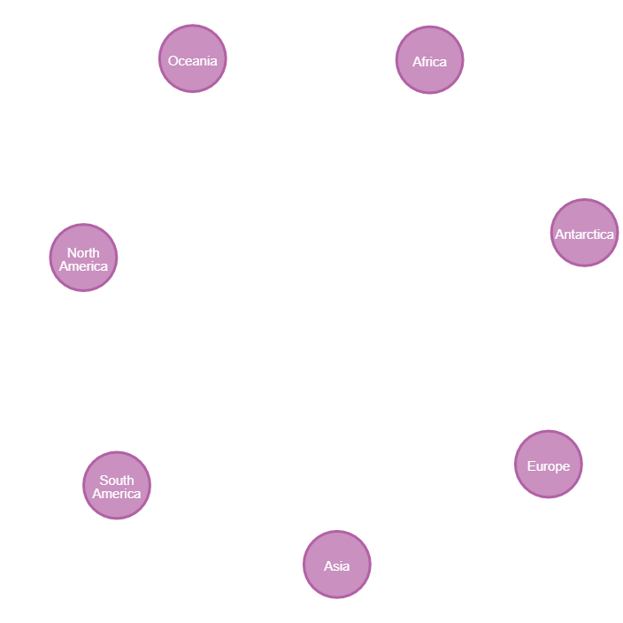
Creating nodes
Graph Database using Neo4j for Continent, Country, Player, Game, Genre, Team, Tournament, Platform Relationships for Esports
We have taken the data manually as well as used .csv to create different nodes.
Continent node (MANUALLY)
Create Continent Nodes Manually: - Create continent nodes for Asia, Europe, Antarctica, Africa, Oceania, North America, and South America.
Query:-
CREATE (node:continent {continentCode: 'AS', continentName: 'Asia'})

Slide 7

Country node:
Create Country Nodes Using a CSV File: -
Load a CSV file containing country and continent codes.
Create country nodes with attributes like country name, two-letter code, three-letter code, and country number.
Establish a relationship between each country node and its corresponding continent node using the "PART_OF" relationship.
Query:
LOAD CSV WITH HEADERS FROM 'file:///country-and-continent-codes-list.csv' AS row
MERGE (c:country {countryName: row.Country_Name})
ON CREATE SET c.twoLetterCode = row.Two_Letter_Country_Code, c.threeLetterCode = row.Three_Letter_Country_Code, c.countryNumber = row.Country_Number

Slide 8

Players node
Create Player Nodes Using a CSV File:
Load a CSV file containing player information, including their highest earning data.
Create player nodes with attributes like player ID, first name, last name, player handle, and total prize won.
Establish a relationship between each player node and their corresponding country node using the "FROM" relationship
Query:
LOAD CSV WITH HEADERS FROM 'file:///highest_earning_players.csv' AS row
MERGE (p:players {playerID: row.PlayerId})
ON CREATE SET p.firstName = row.NameFirst, p.lastName = row.NameLast, p.playerHandle = row.CurrentHandle, p.totalPrizeWon = row.TotalUSDPrize

Slide 9
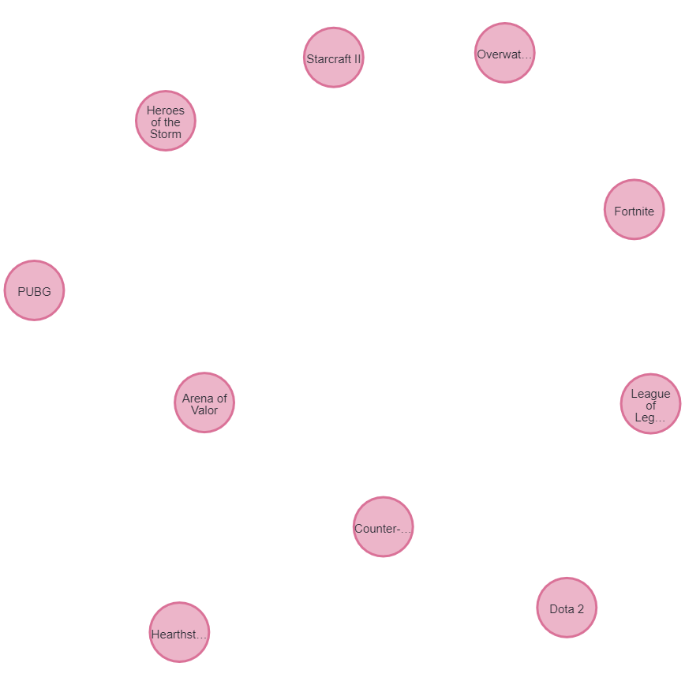
Game node
Create Game Nodes Manually:
Create game nodes with attributes like game name.
Establish a relationship between each player node and the corresponding game node using the "PLAYS" relationship.
Query:
MERGE (g:games {gameName: 'Counter-Strike: Global Offensive'})

Slide 10
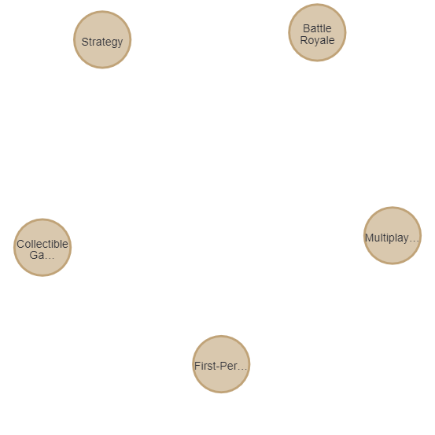
Genre node:
Create Genre Nodes Manually:
Create genre nodes with attributes like genre name.
Establish a relationship between each player node and the corresponding genre node using the "PLAYS_IN" relationship.
Query:
MERGE (g:genre {genreName: 'First-Person Shooter'})

Slide 11

Team node:
Create Team Nodes Using a CSV File:
Load a CSV file containing information about the highest earning teams. –
Create team nodes with attributes like team ID, team name, total prize won, and tournaments played.
Establish a relationship between each team node and the corresponding game node using the "PLAYS" relationship.
Establish a relationship between each team node and the corresponding genre node using the "PLAYS_IN" relationship.
Query:
LOAD CSV WITH HEADERS FROM 'file:///highest_earning_teams.csv' AS row
MERGE (t:teams {teamID: row.TeamId})
ON CREATE SET t.teamName = row.TeamName, t.totalPrizeWon = row.TotalUSDPrize, t.tournamentsPlayed = row.TotalTournaments

Slide 12
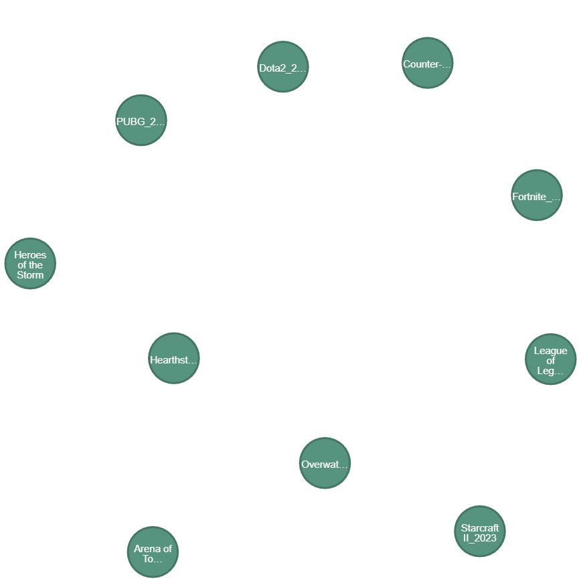
Tournament node:
Create Tournament Nodes Manually:
Create genre nodes with attributes like tournament name.
Establish a relationship between each game node and the corresponding tournament node using the “HAS" relationship and “HELD” relationship between tournament node and corresponding country node.
Query:
MERGE (t1:tournaments {tournamentName: 'Overwatch_2023'})
ON CREATE SET t1.startDate = date('2023-05-01'), t1.endDate = date('2023-05-07')

Slide 13
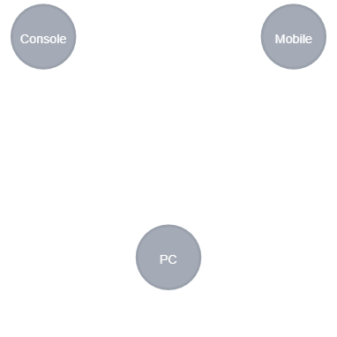
Platform node:
Create Platform Nodes Manually:
Create platform nodes with attributes like platform name.
Establish a relationship between each platform node and the corresponding tournament node using the “PLAYED_ON" relationship.
Creating Query:
MERGE (p1:platform {platformName: 'PC’})
Relationship Query:
MATCH (t:tournaments {tournamentName: 'Overwatch_2023'}), (p:platform {platformName: 'PC'})
MERGE (t)-[:PLAYED_ON]->(p)

Slide 14
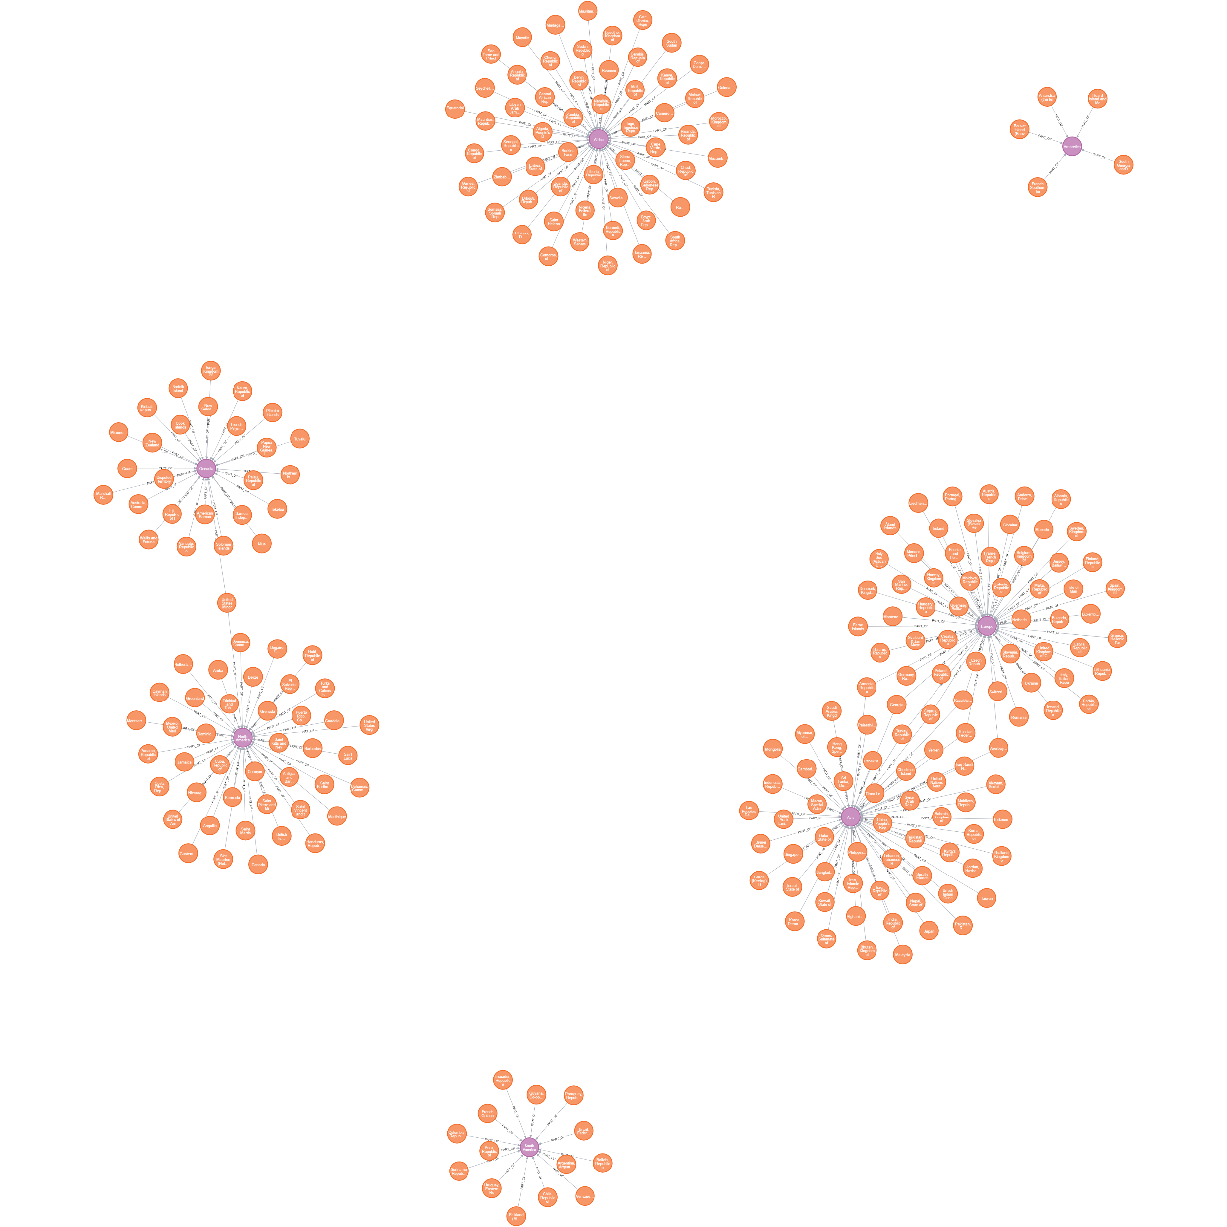
Relations:
Relations between country and continent
Relation is labeled as “PART_OF”
Code of the relation:
MATCH (con:continent {continentName: row.Continent_Name})
MATCH (cou:country {countryName: row.Country_Name})
CREATE (cou)-[:PART_OF]->(con)

Slide 15
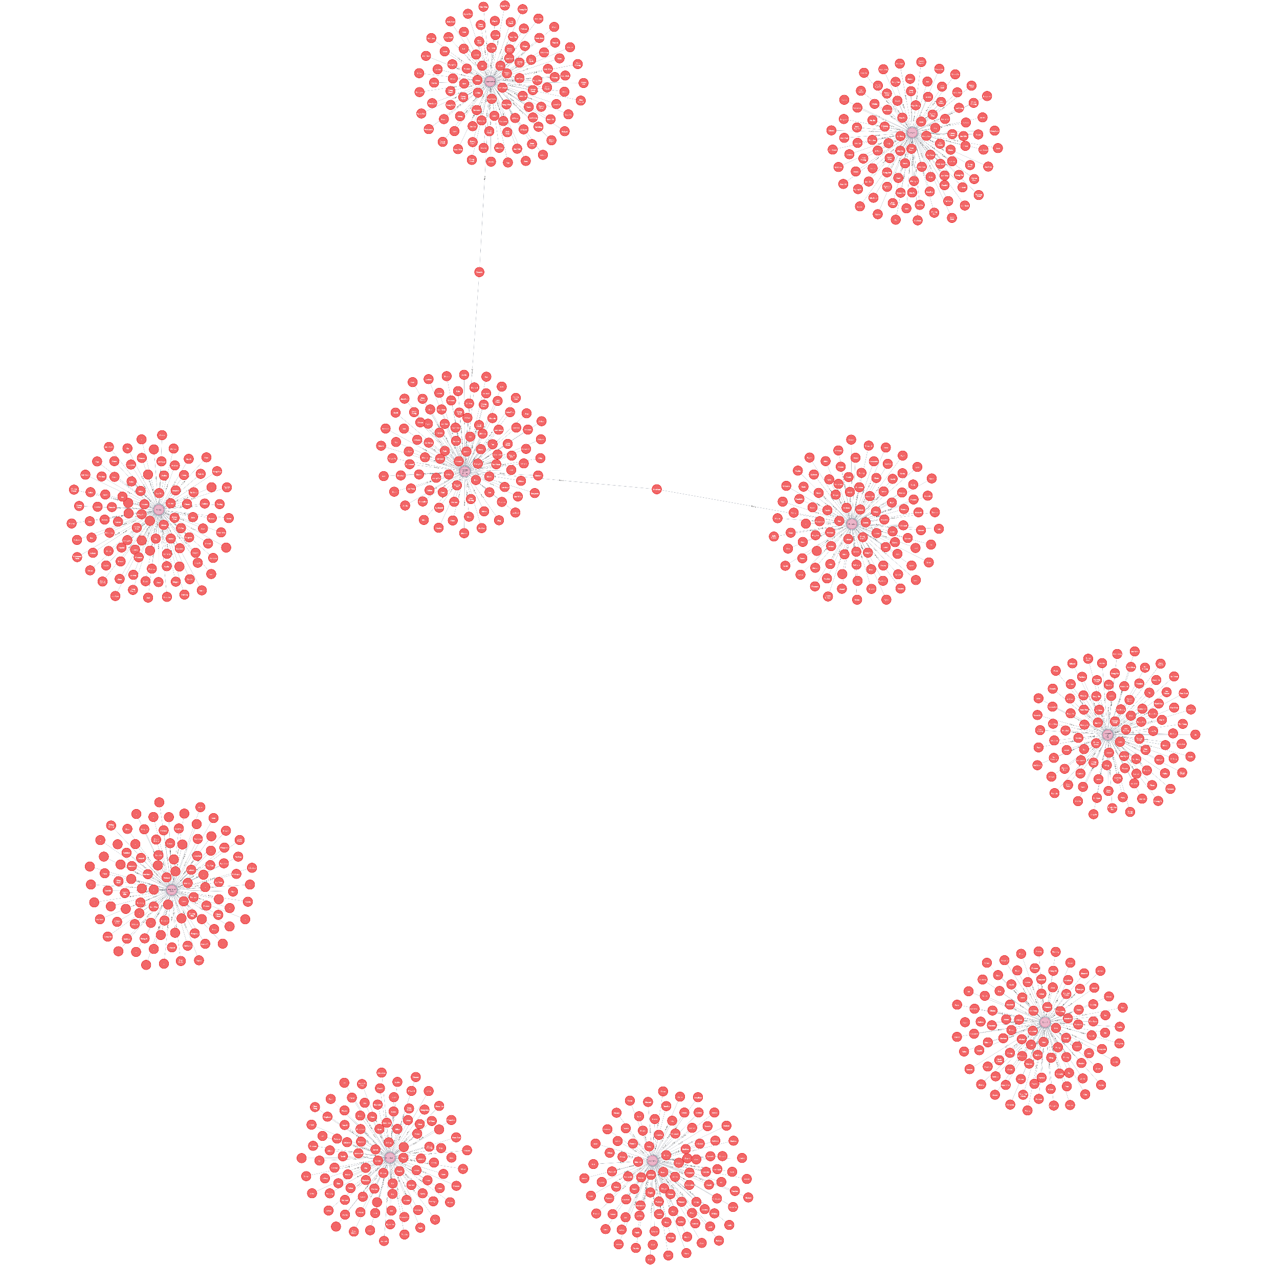
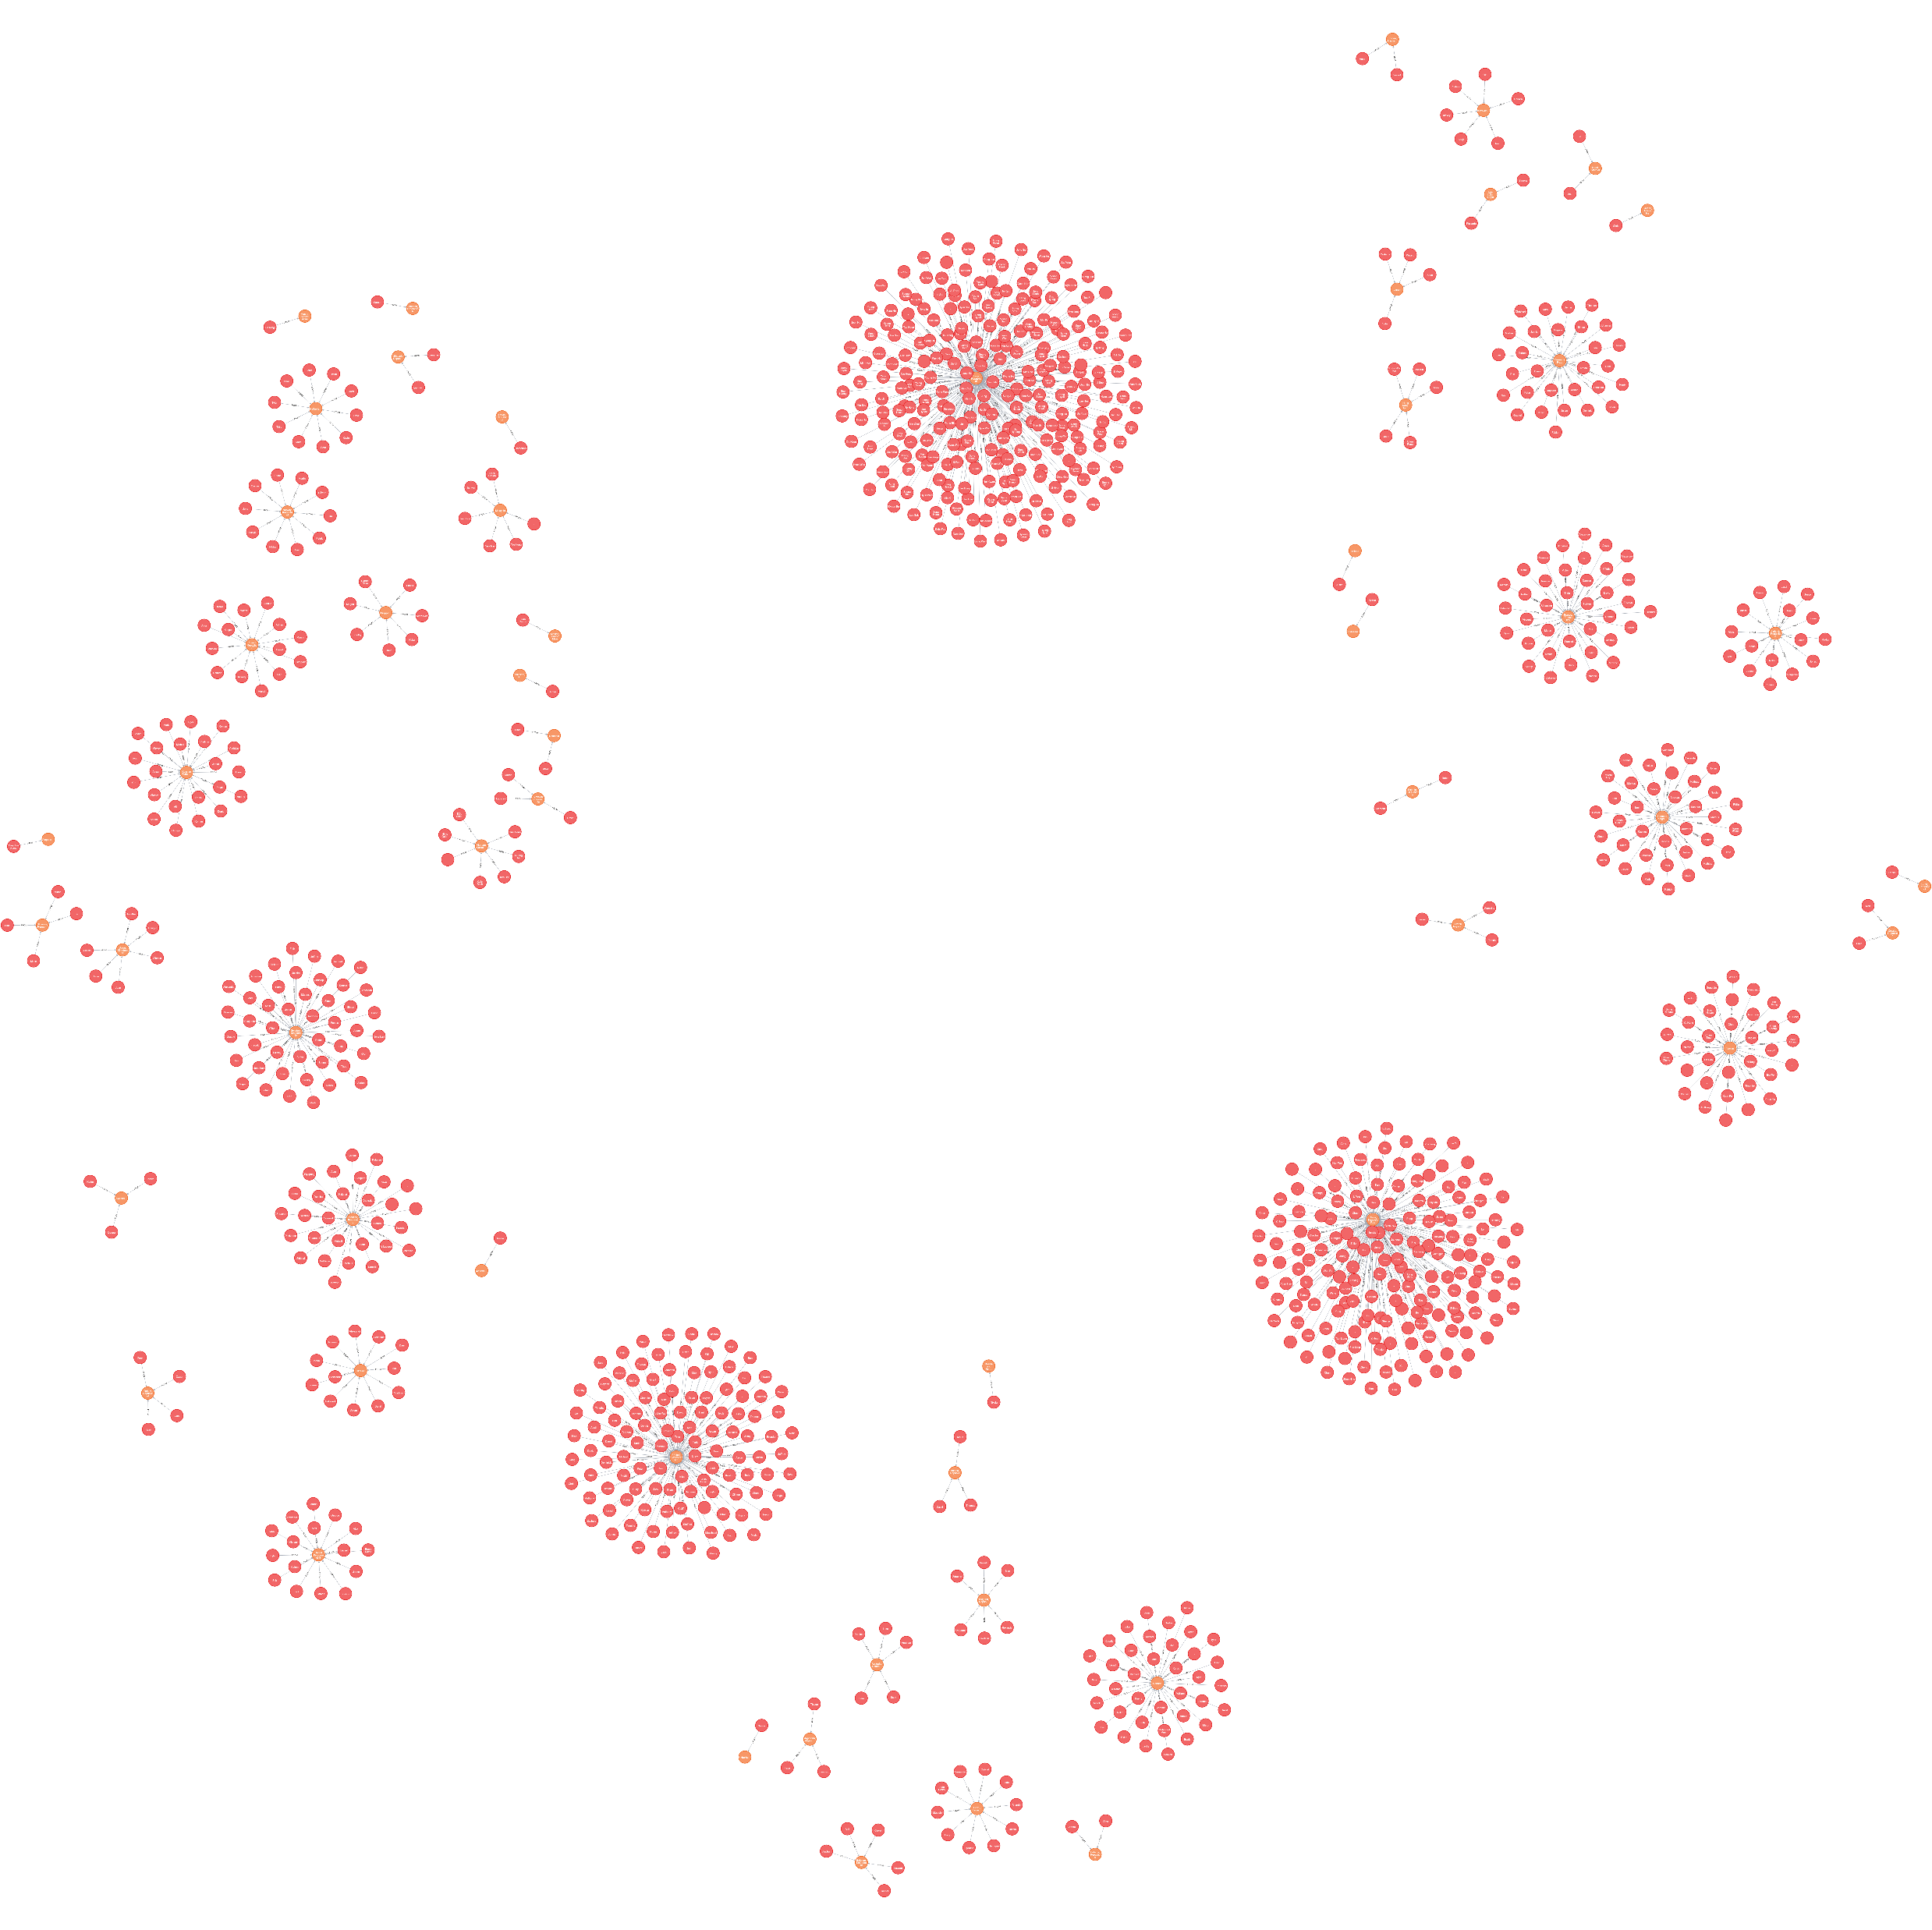
2. Relation between players and country
The label use for the relationship between the players and the country is “FROM”
CODE OF THE RELATION:
MATCH (c:country {twoLetterCode: TOUPPER(row.CountryCode)})
MATCH (p:players {playerID: row.PlayerId})
MERGE (p)-[:FROM]->(c)
3.Relation between players and games:
The label use for the relationship between players and games is “PLAYS”.
CODE OF THE RELATION:
MATCH (p:players {playerID: row.PlayerId})
MATCH (g:games {gameName: row.Game})
CREATE (p)-[:PLAYS]->(g)

Slide 16
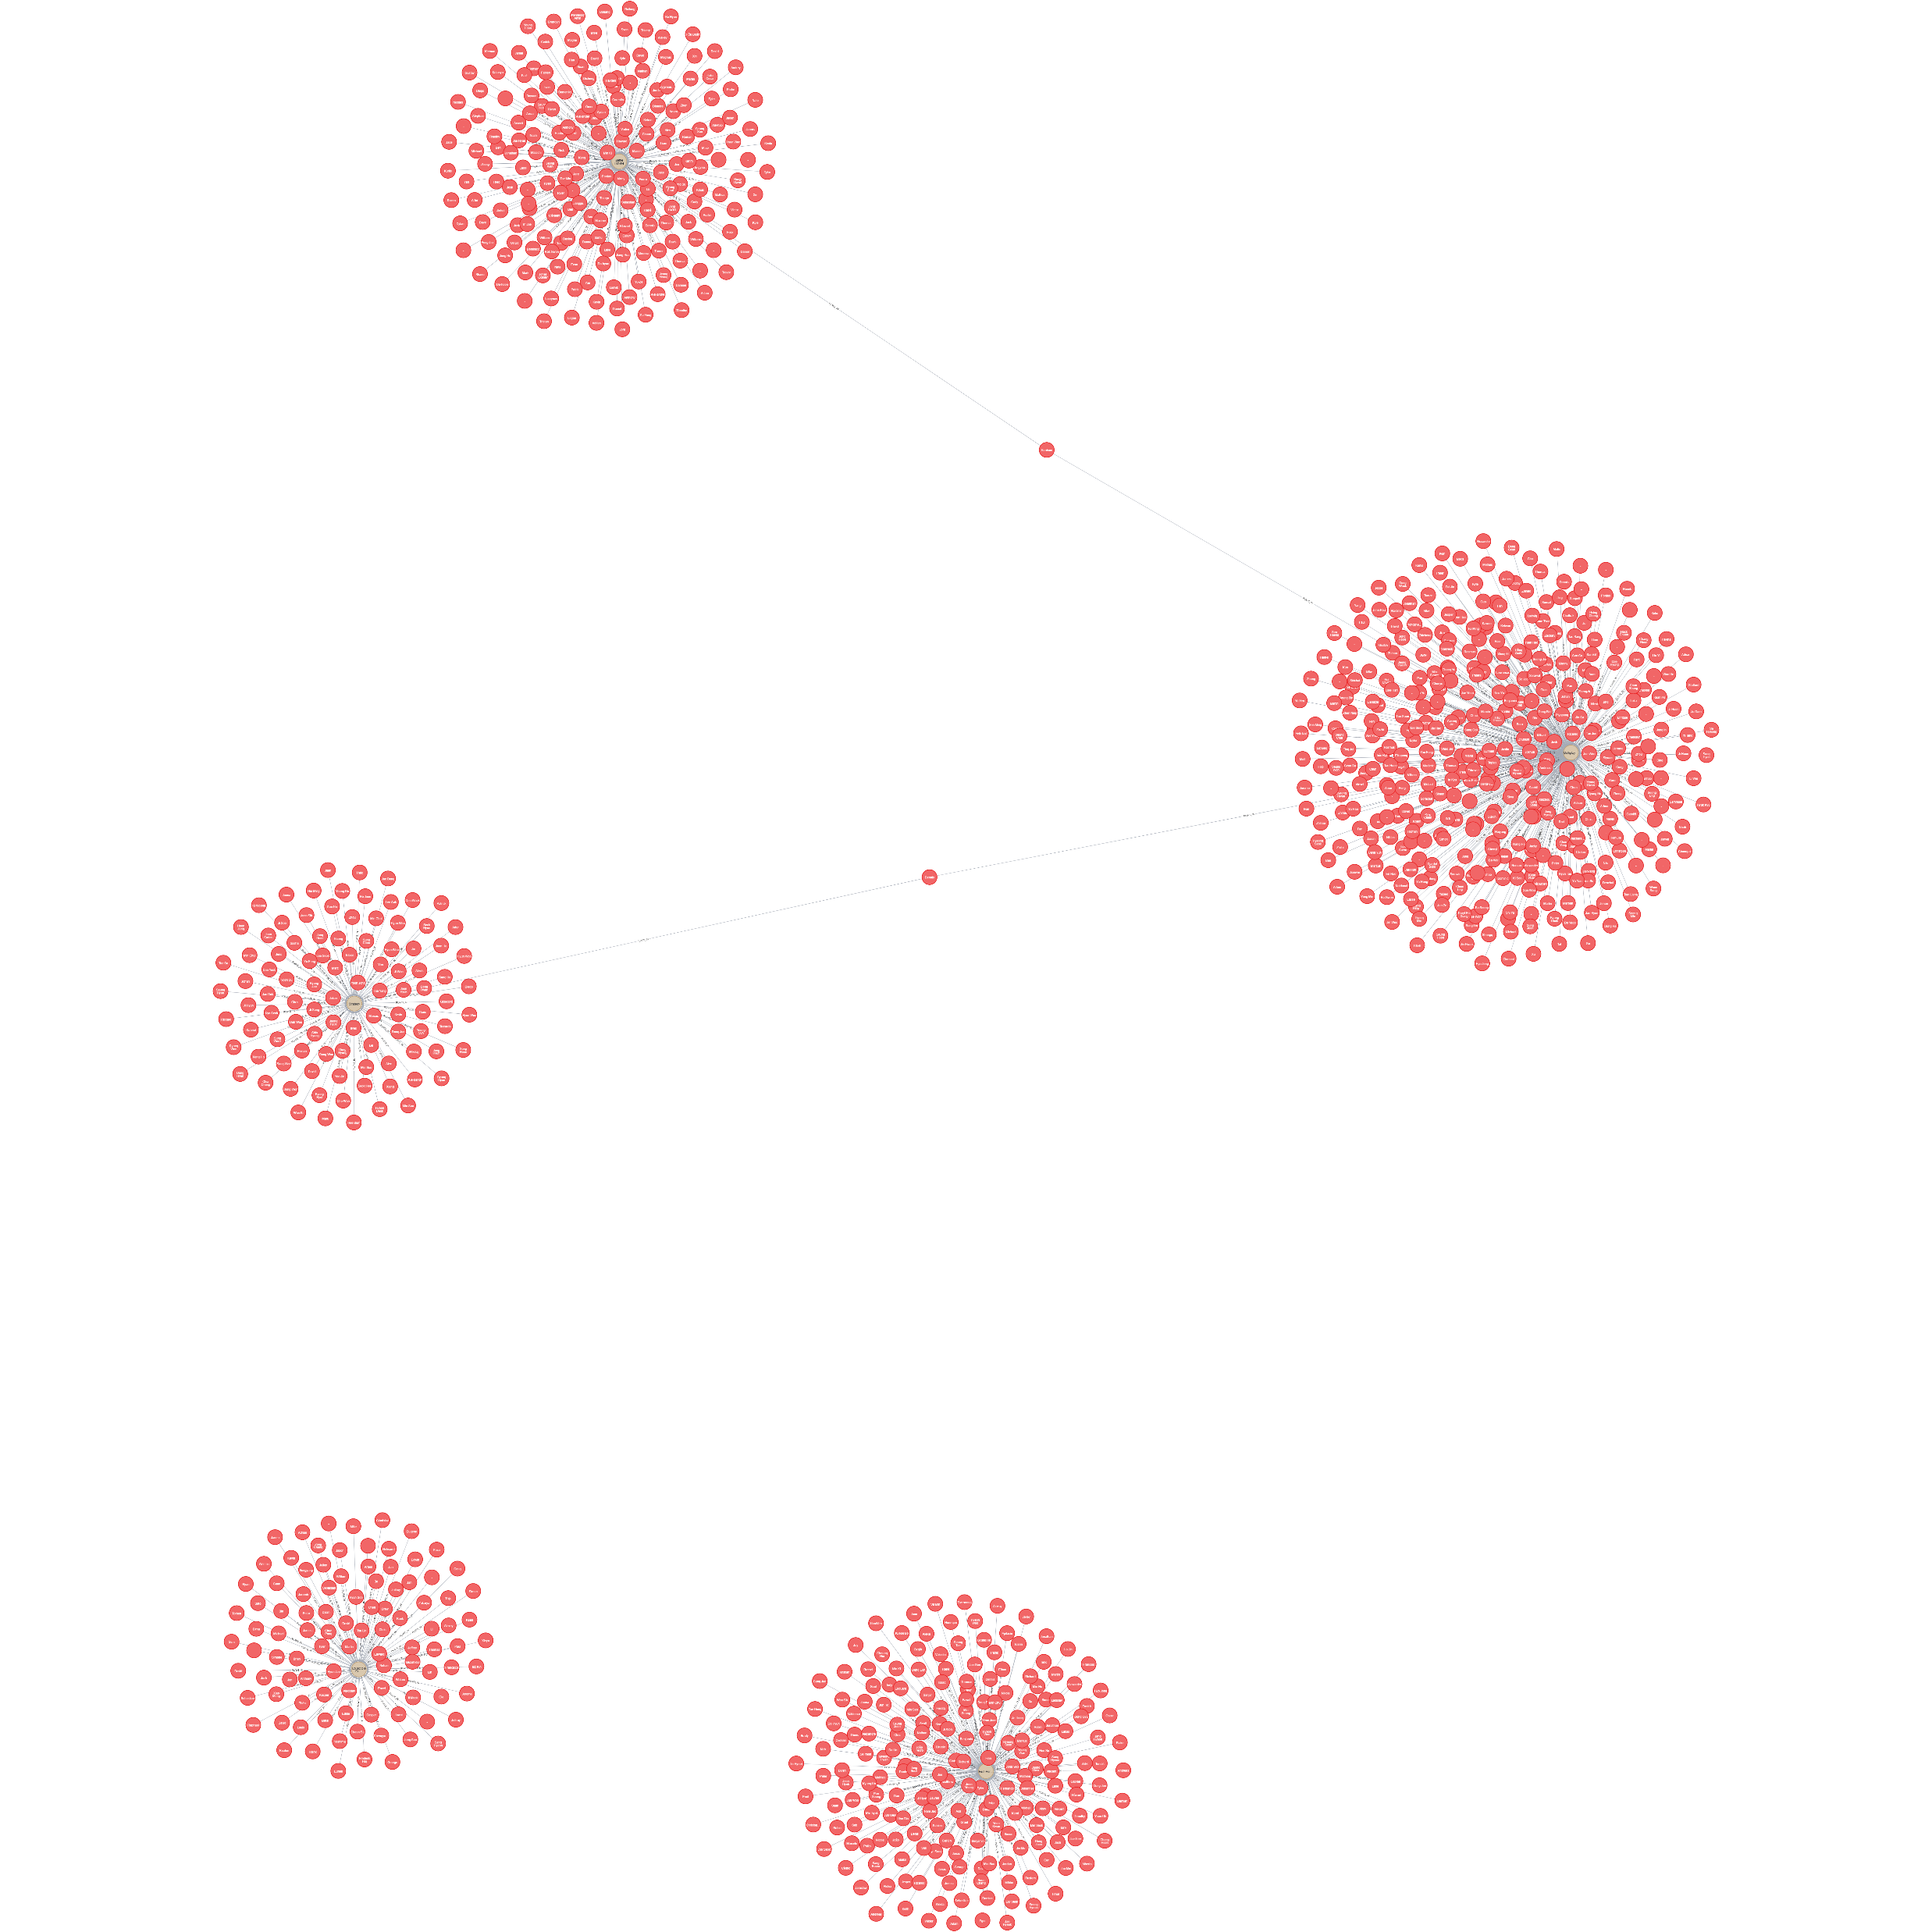
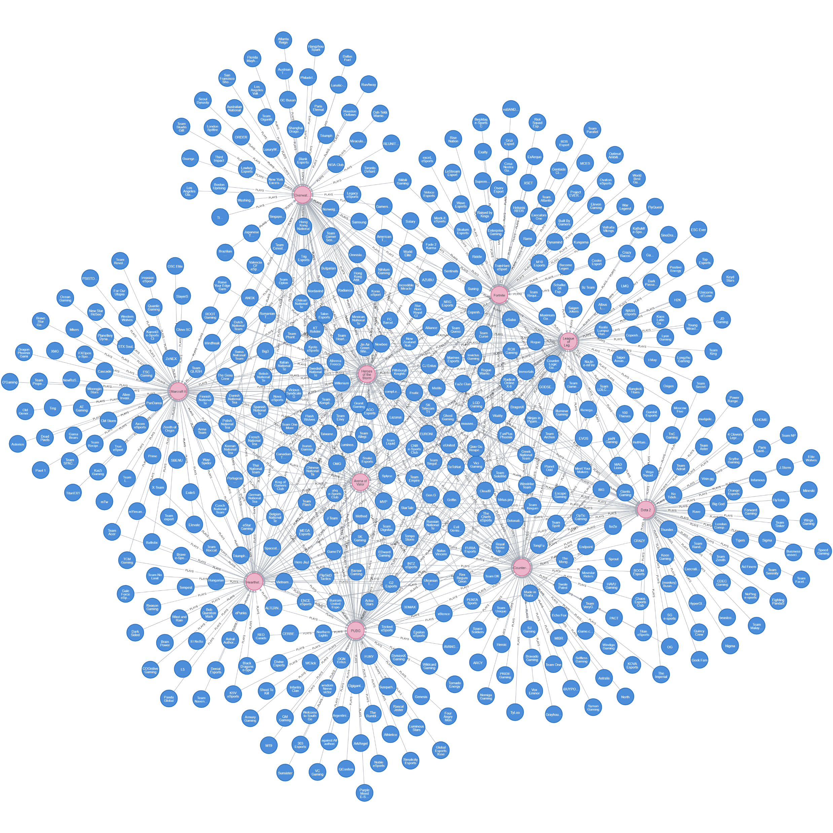
4. Relationship between Players and genre:
The label use for the relationship between players and genre is
“PLAYS_IN”
The code of the relationship is:
MATCH (p:players {playerID: row.PlayerId})
MATCH (gen:genre {genreName: row.Genre})
CREATE (p)-[:PLAYS_IN]->(gen)
5. Relationship between the teams and games:
The label use for the relationship between teams and games is
“PLAYS”
The code of the relationship is :
MATCH (t:teams {teamID: row.TeamId})
MATCH (g:games {gameName: row.Game})
CREATE (t)-[:PLAYS]->(g)

Slide 17
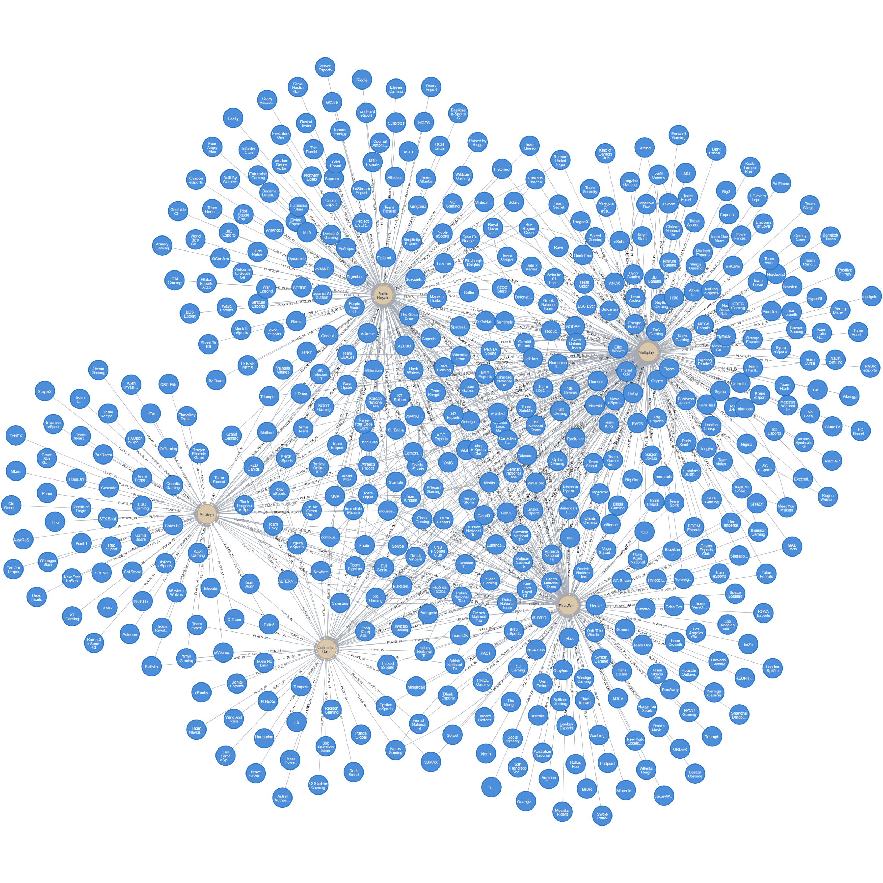
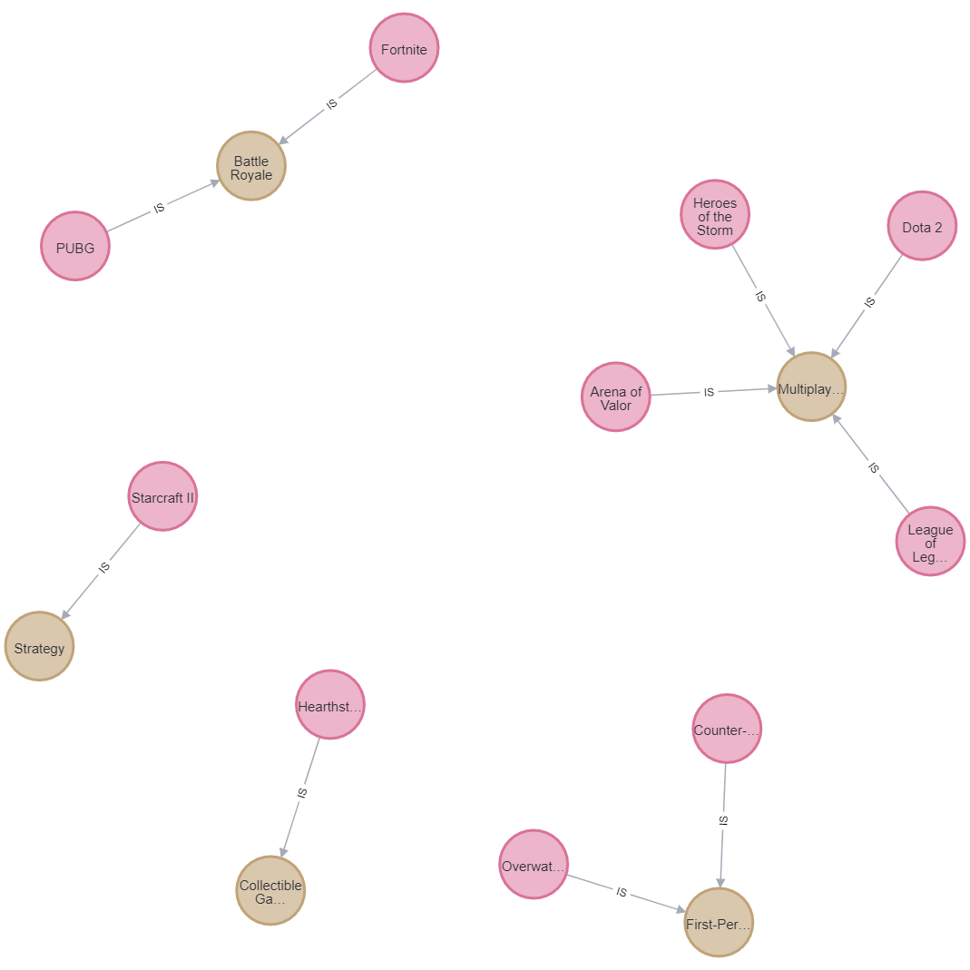
6. Relationship between Teams and genre:
The label use for the relationship between teams and genre
“PLAYS_IN”
The code of the relationship is :
MATCH (t:teams {teamID: row.TeamId})
MATCH (gen:genre {genreName: row.Genre})
CREATE (t)-[:PLAYS_IN]->(gen)
7. Relationship between games and genre:
The label use for the relationship between games and genre:
“IS”
The code of the relationship is :
MATCH (g:games {gameName: row.Game})
MATCH (gen:genre {genreName: row.Genre})
MERGE (g)-[:IS]->(gen)

Slide 18
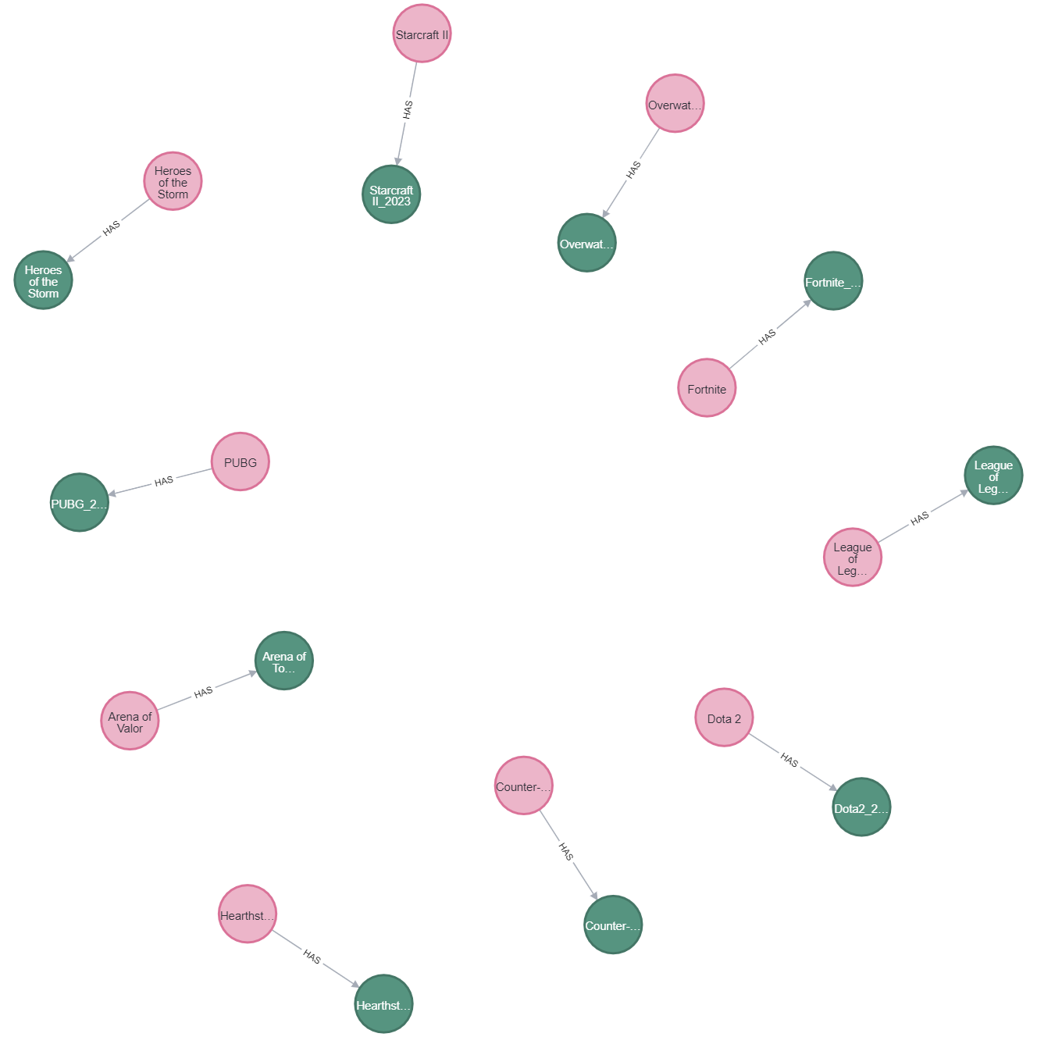
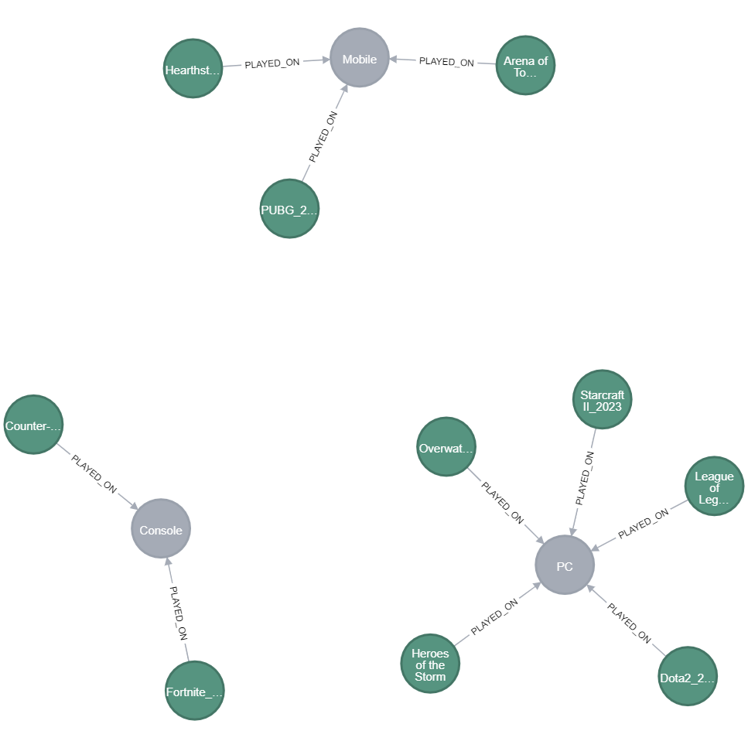
8. Relationship between games and tournaments:
The label use for the relationship between games and tournments is “HAS”
The code for the relationship is:
MERGE (t1:tournaments {tournamentName: 'Overwatch_2023'})
ON CREATE SET t1.startDate = date('2023-05-01'), t1.endDate = date('2023-05-07')
WITH t1
MATCH (g:games {gameName: 'Overwatch'})
MERGE (g)-[:HAS]->(t1)
9. Relationship between tournaments and platforms:
The label use for the relationship between tournments and platform is “ PLAYED_ON”
The code of the relationship is:
MATCH (t:tournaments {tournamentName: 'Overwatch_2023'}), (p:platform {platformName: 'PC'})
MERGE (t)-[:PLAYED_ON]->(p)

Slide 19
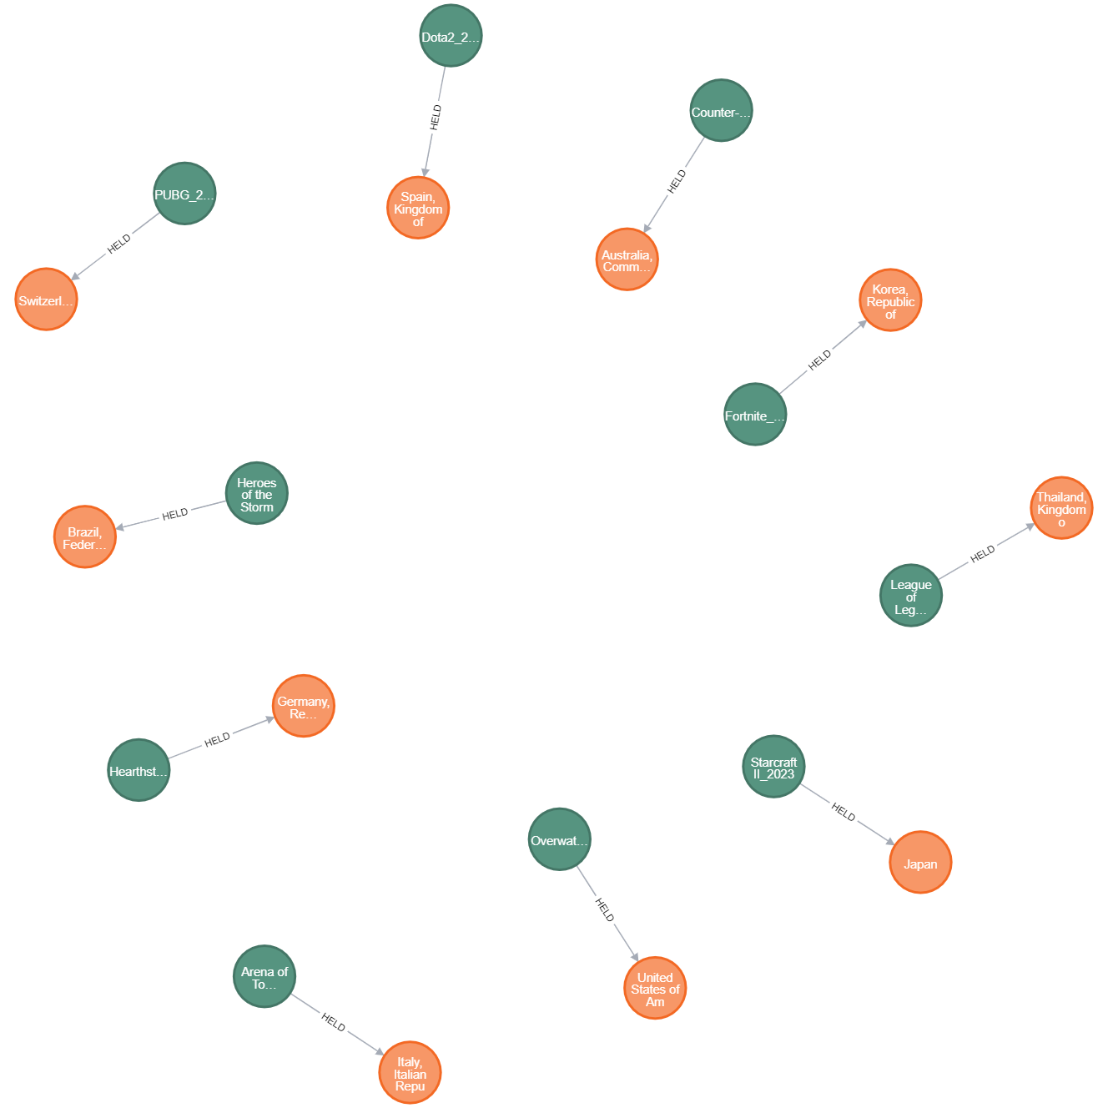
10. Relationship between Tournaments and countries:
The label use for the relationship between tournament and countries
is “HELD”
The code of the relationship tournament and countries:
MERGE (t1:tournaments {tournamentName: 'Overwatch_2023'})
ON CREATE SET t1.startDate = date('2023-05-01'), t1.endDate = date('2023-05-07')
WITH t1
MATCH (c:country {countryName: 'United States of America'})
MERGE (t1)-[:HELD]->(c)

Slide 20
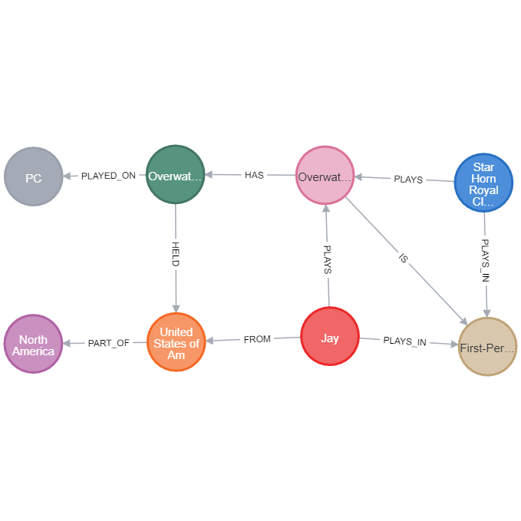
Loops in Graph:
Query to retrieve the graph:
MATCH (c:country)-[:PART_OF]->(ct:continent {continentName: 'North America'})
MATCH (p:players)-[:FROM]->(c)
MATCH (p)-[:PLAYS]->(g:games)
MATCH (p)-[:PLAYS_IN]->(gen:genre)
MATCH (t:teams)-[:PLAYS]->(g)
MATCH (t:teams)-[:PLAYS_IN]->(gen)
MATCH (g)-[:IS]->(gen)
MATCH (g)-[:HAS]->(tour:tournaments)
MATCH (tour)-[:HELD]->(c)
MATCH (tour)-[:PLAYED_ON]->(plat:platform)
RETURN ct, c, p, t, g, gen, tour, plat
LIMIT 1

Slide 21

NULL NODES:
A null node in Neo4j is a node that doesn't exist in the database.
It can be created when a non-existent node is referenced or when a node is deleted but relationships are not removed.
Null nodes are represented as an empty set of parentheses in Cypher.
They can cause issues in queries and should be avoided by ensuring referenced nodes exist in the database and cleaning up orphaned relationships.
Null properties, which represent missing or unknown data, are different from null nodes in Neo4j.

Slide 22
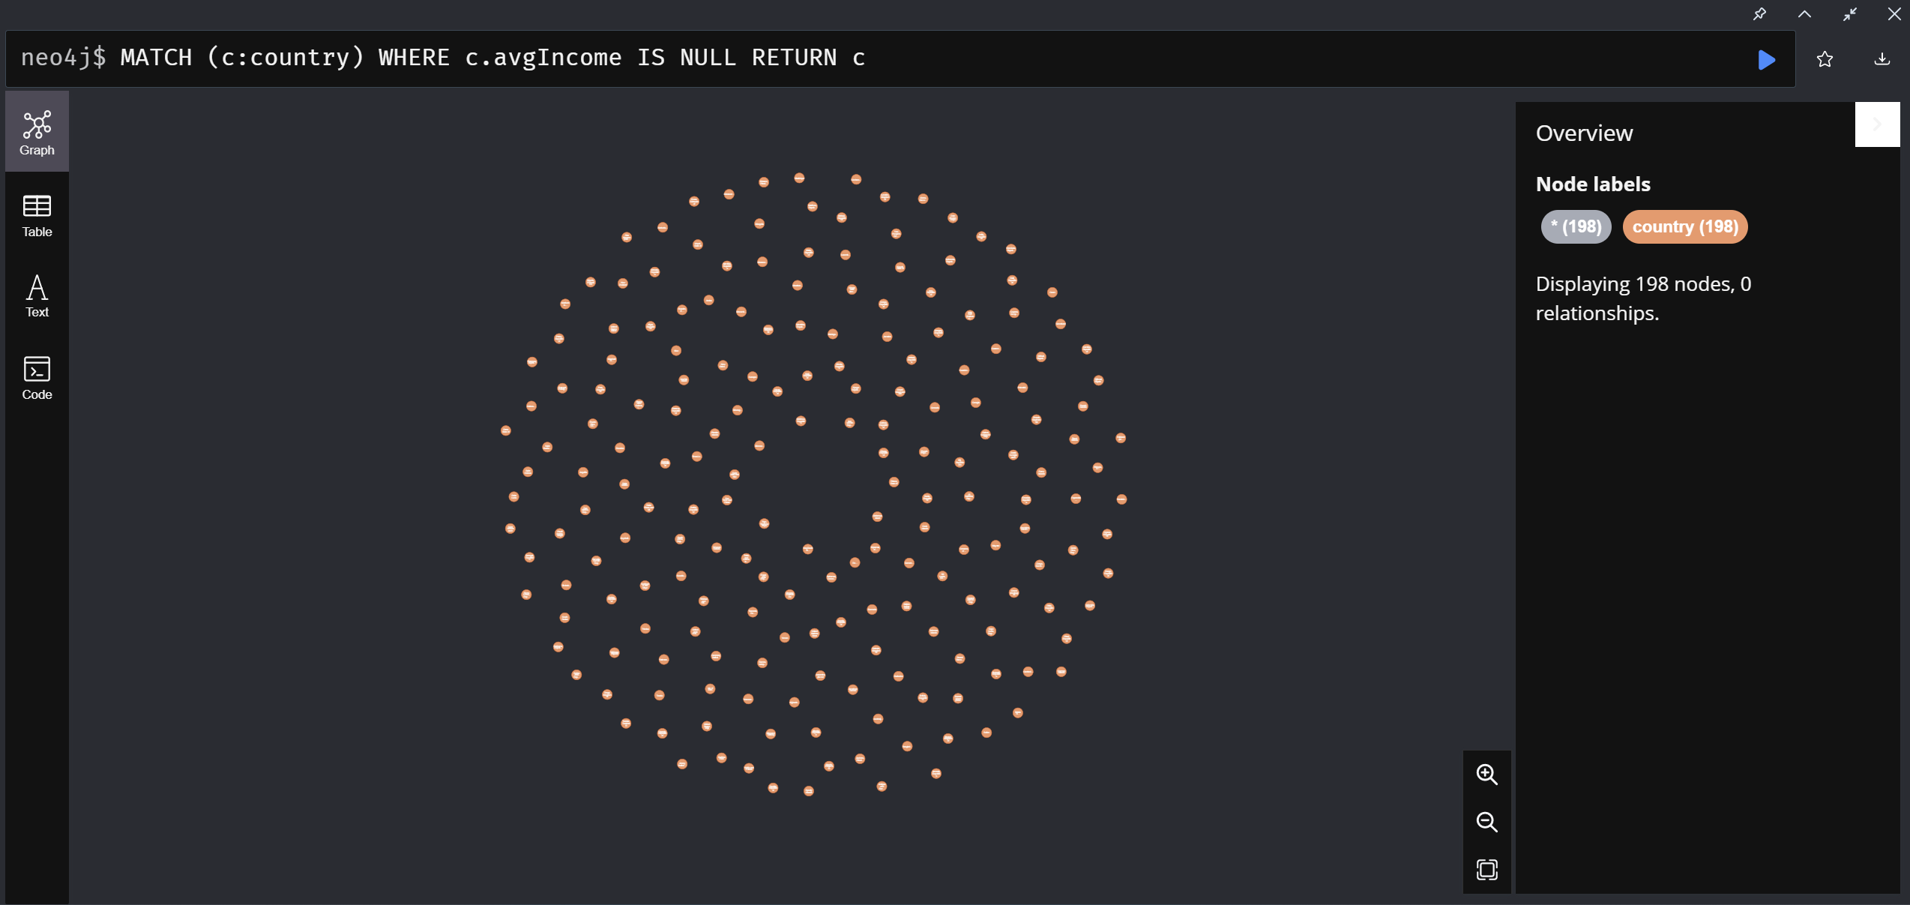
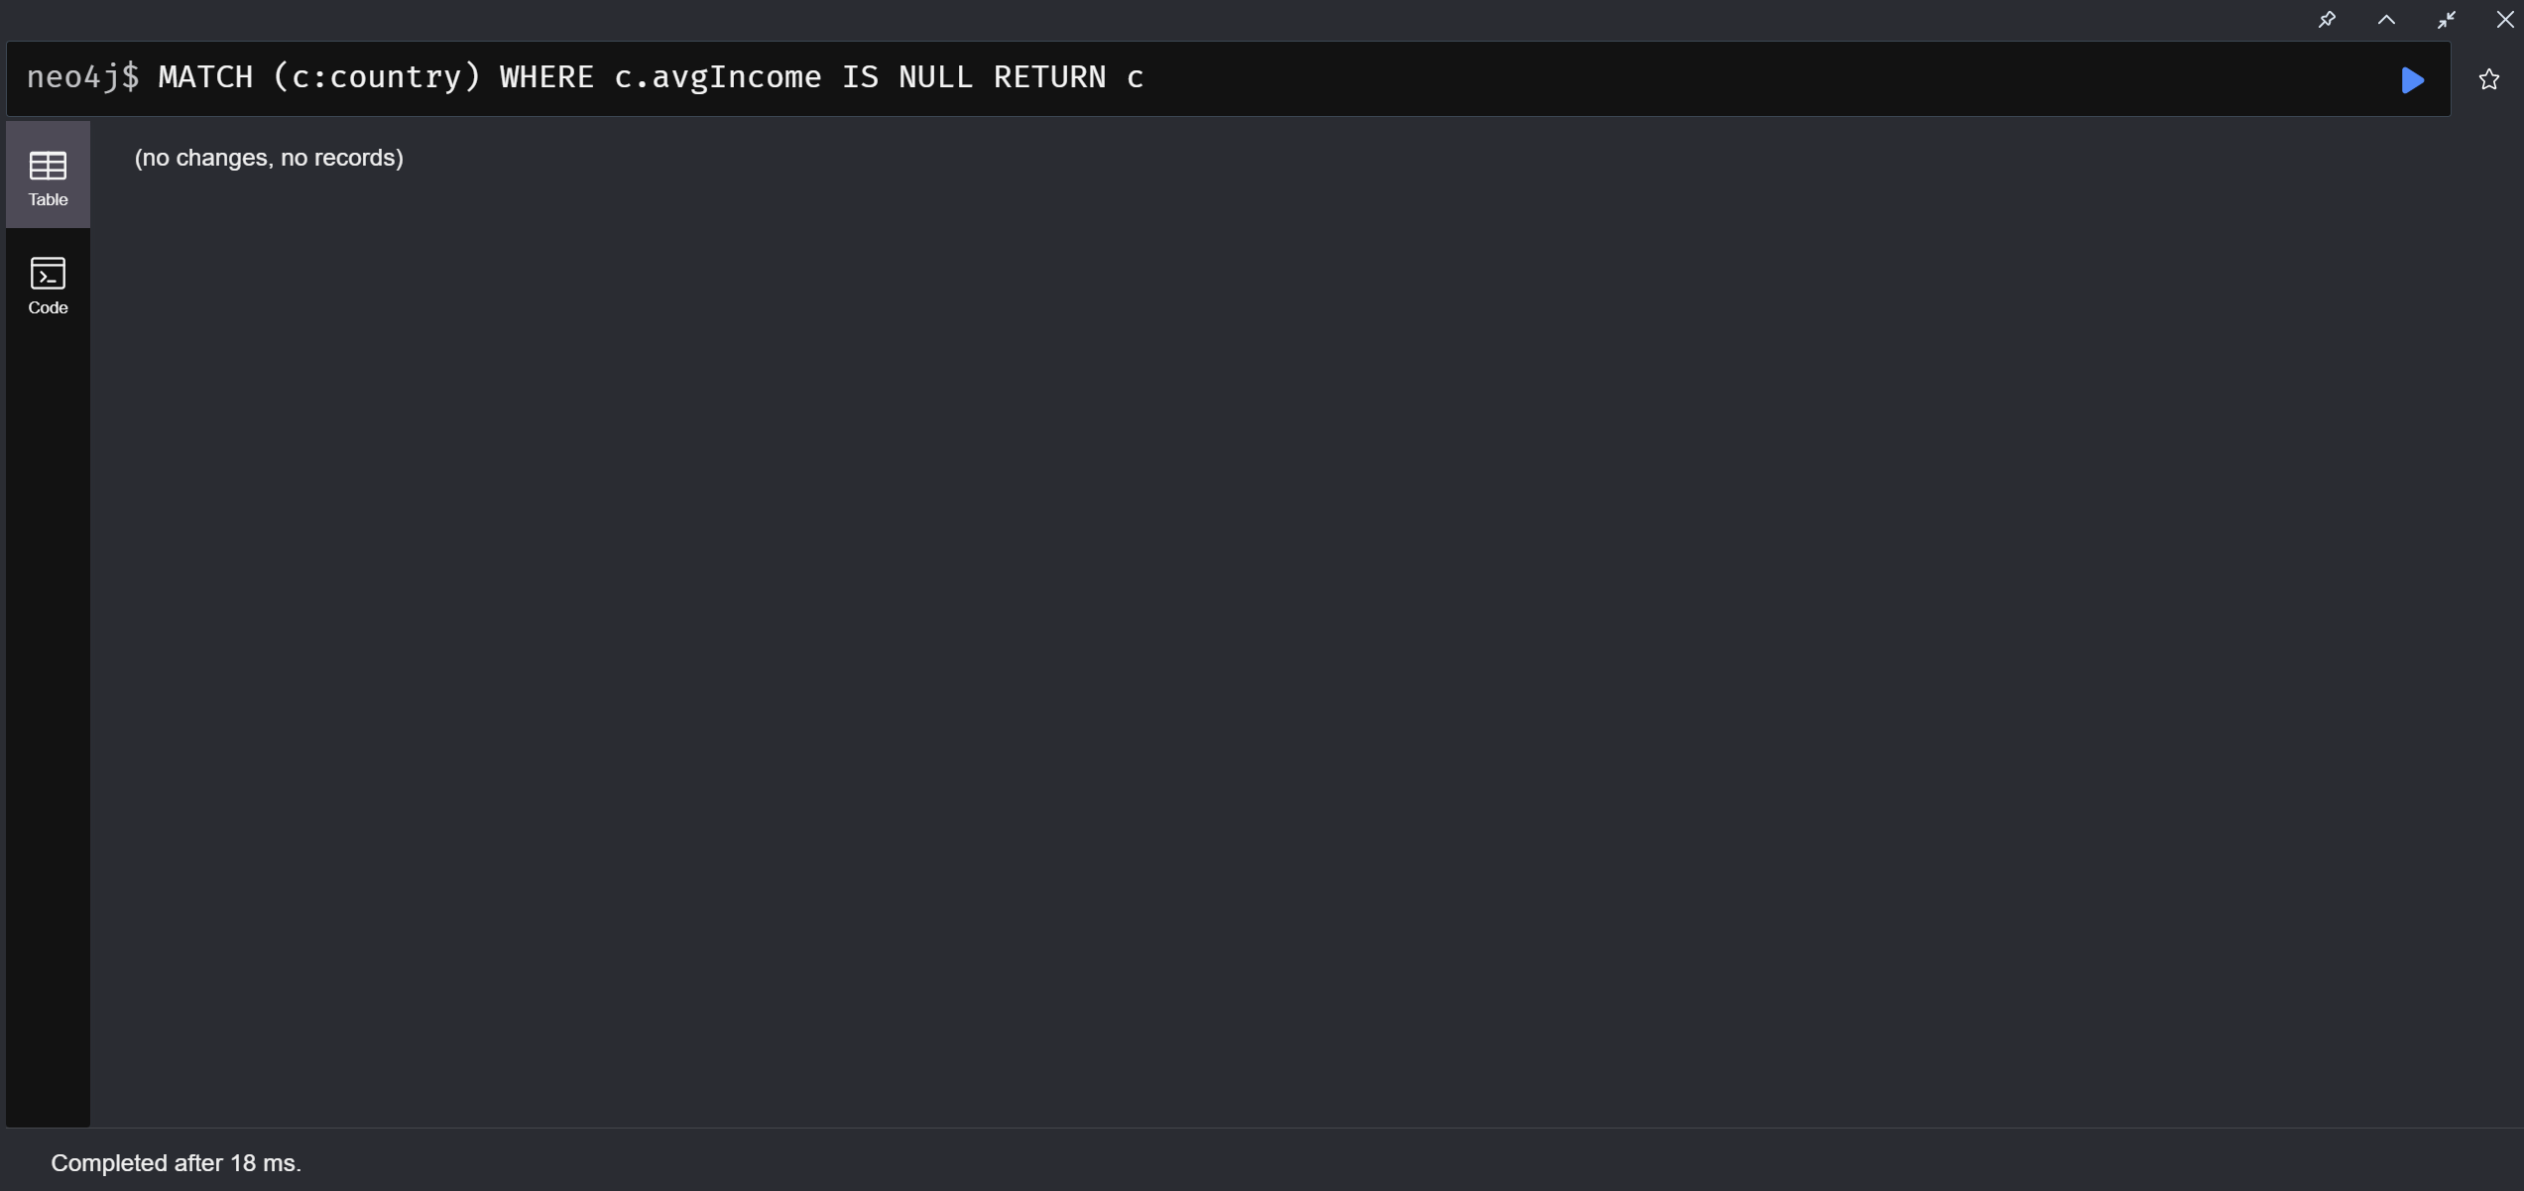
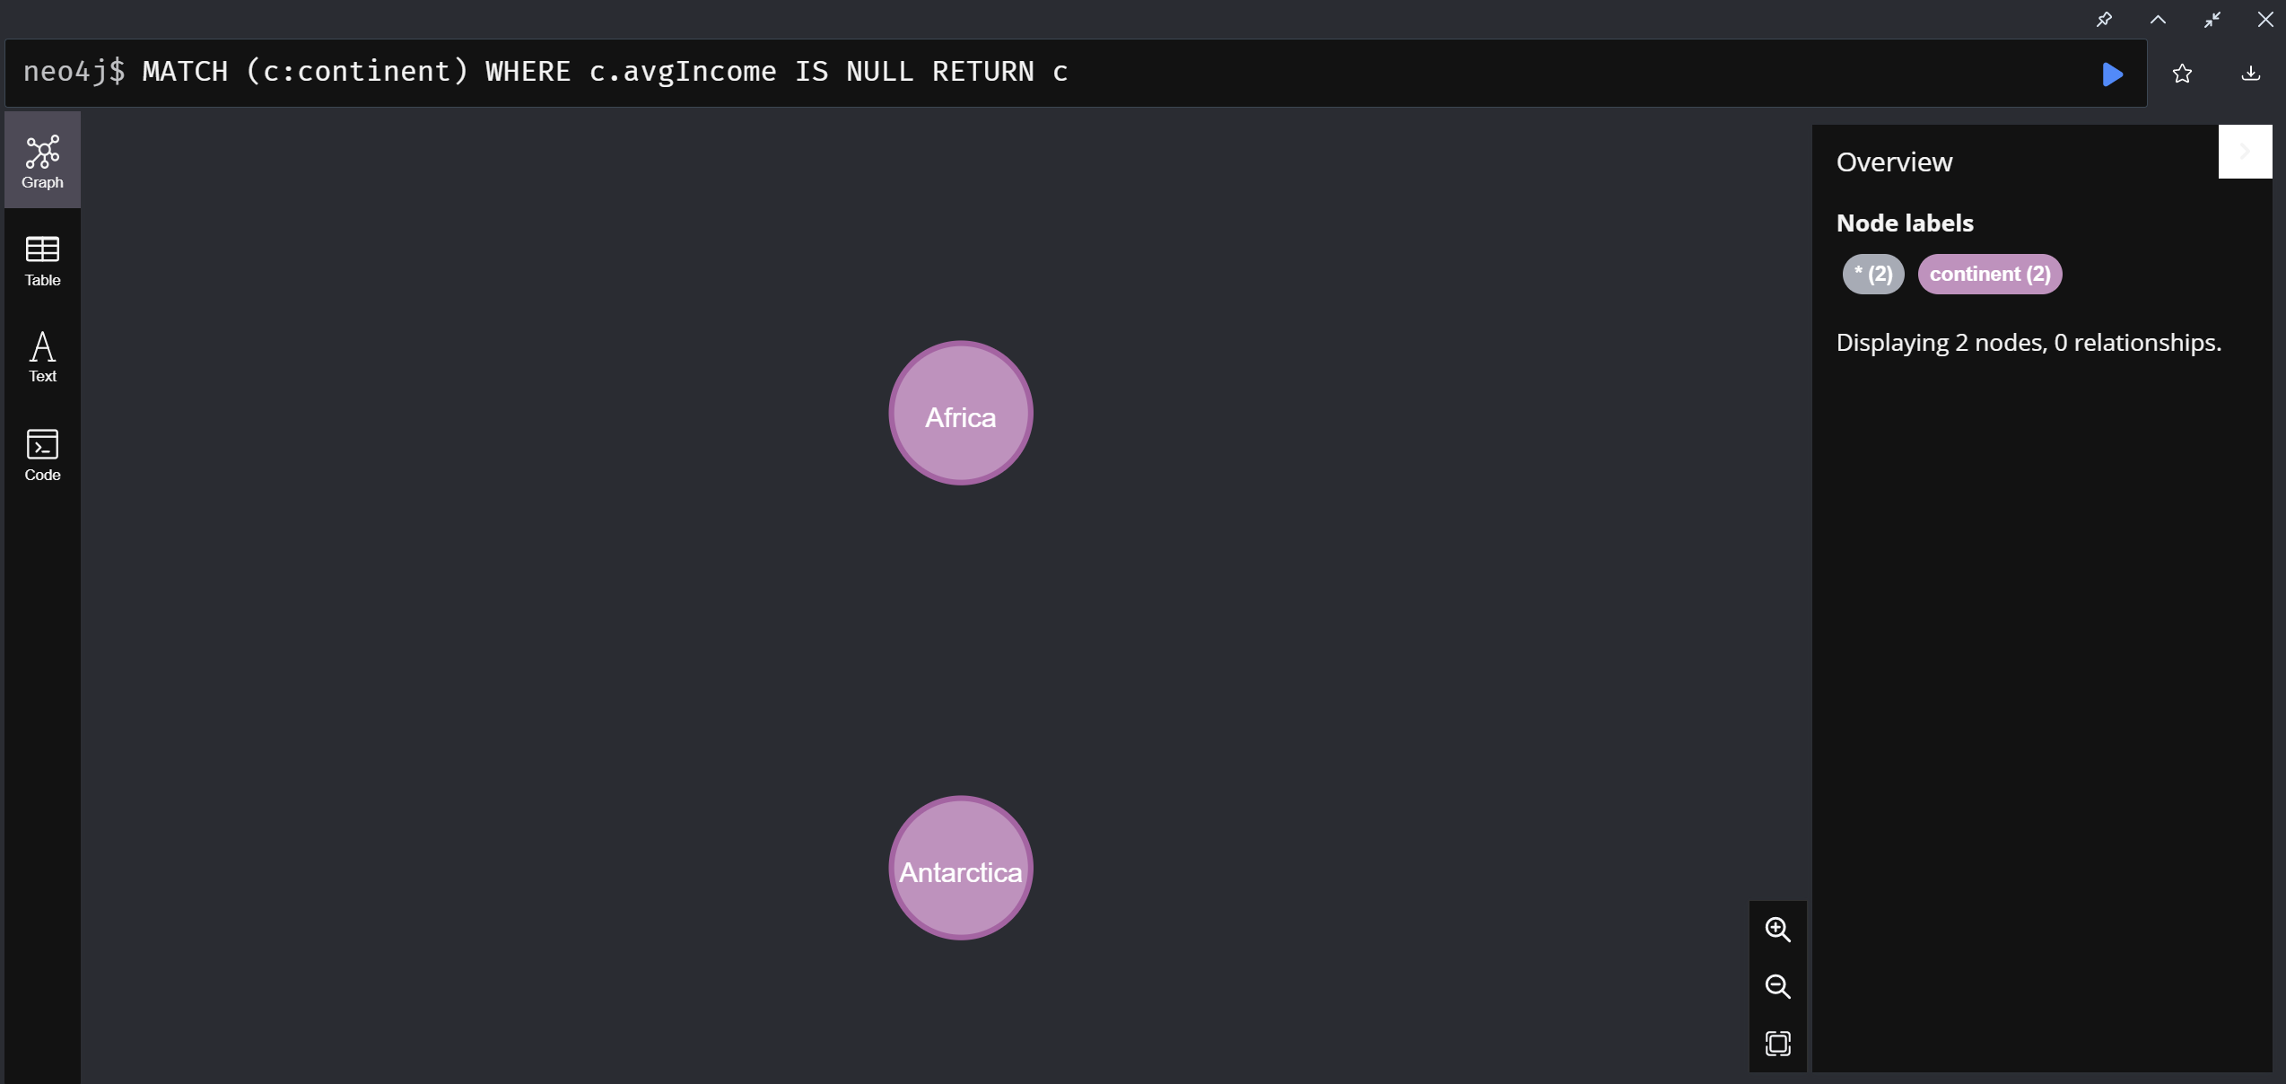
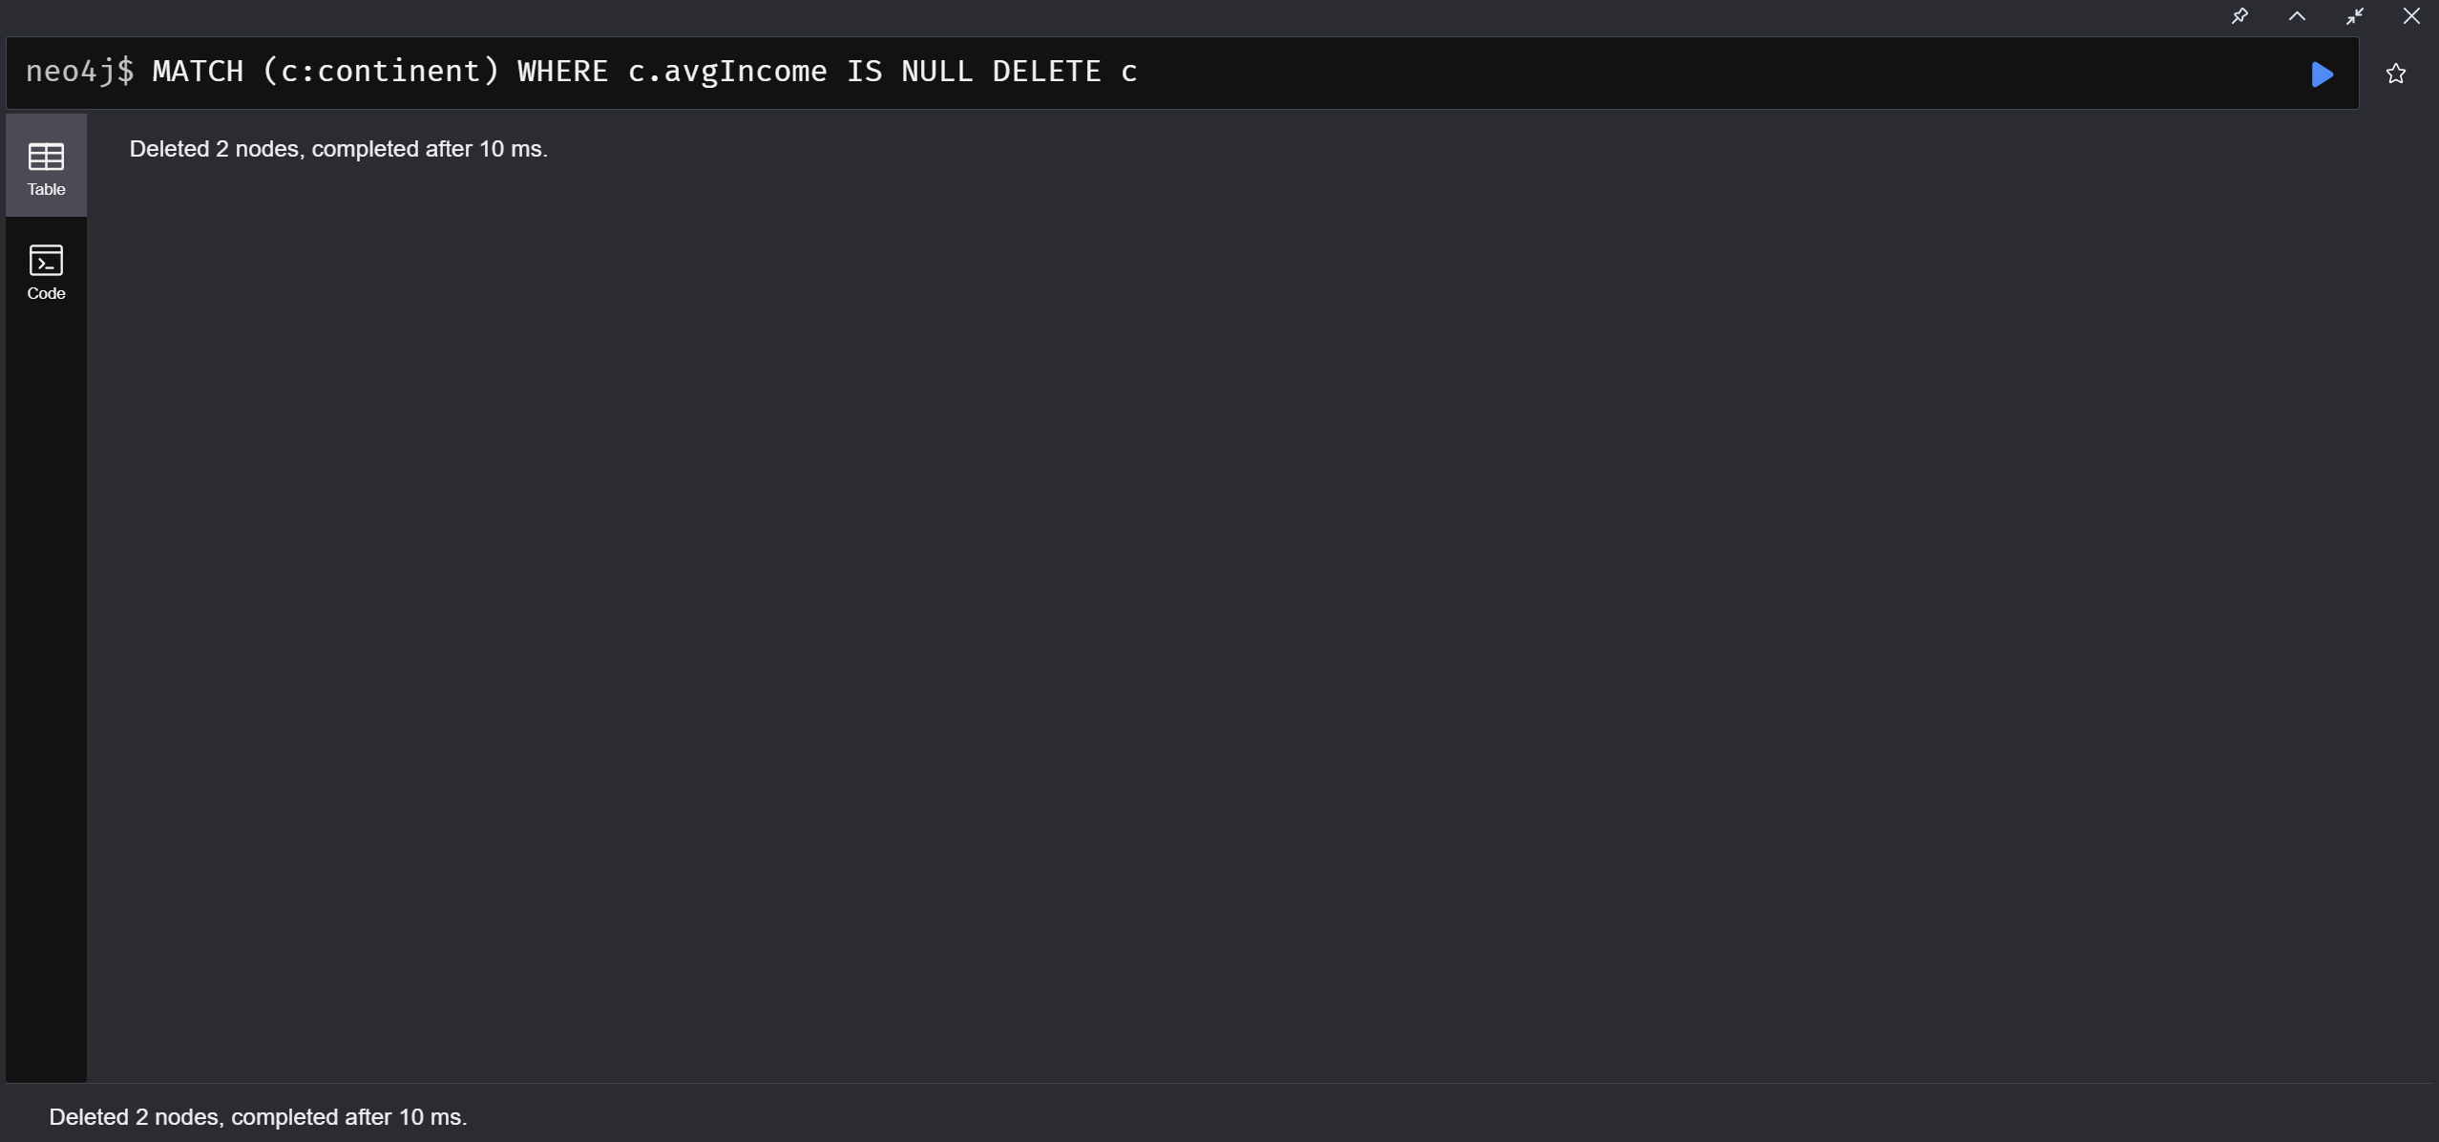
NULL NODE COMPARISION:
NULL VALUES IN AVERAGE INCOME OF COUNTRIES,
BEFOR AND AFTER
NULL VALUES IN AVERAGE INCOME OF CONTINENTS
BEFORE AND AFTER

Slide 23
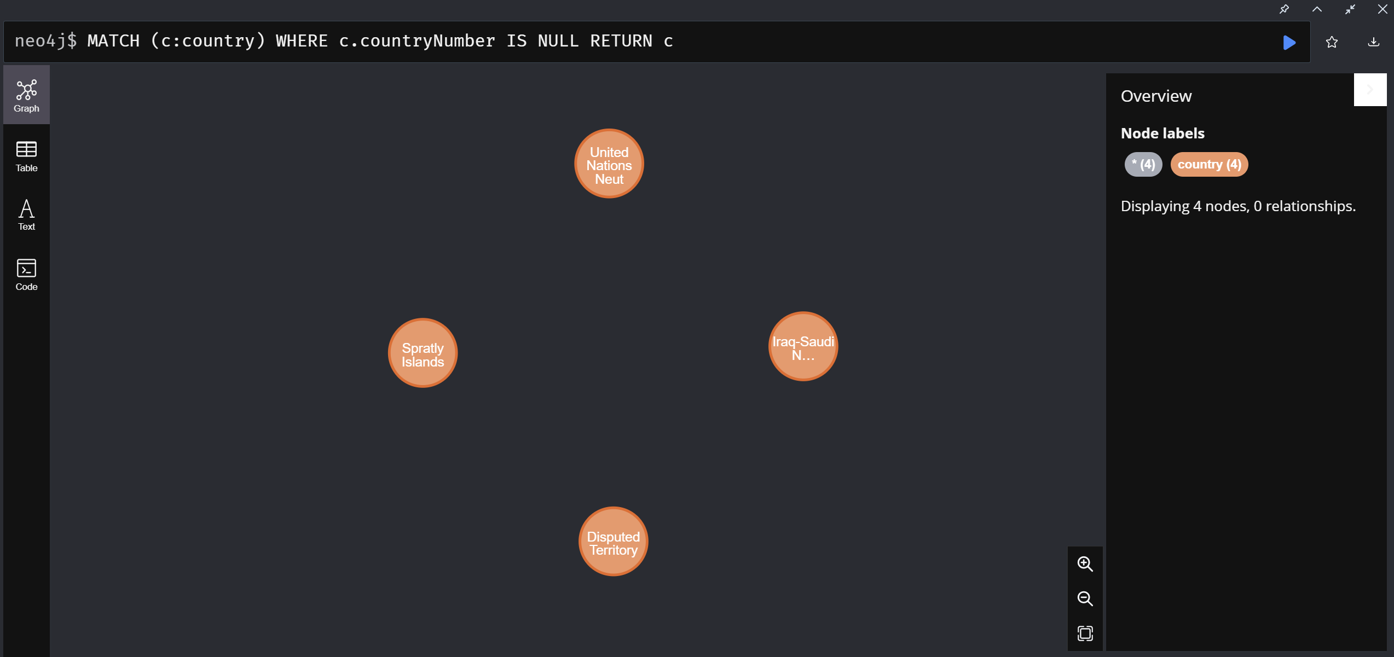

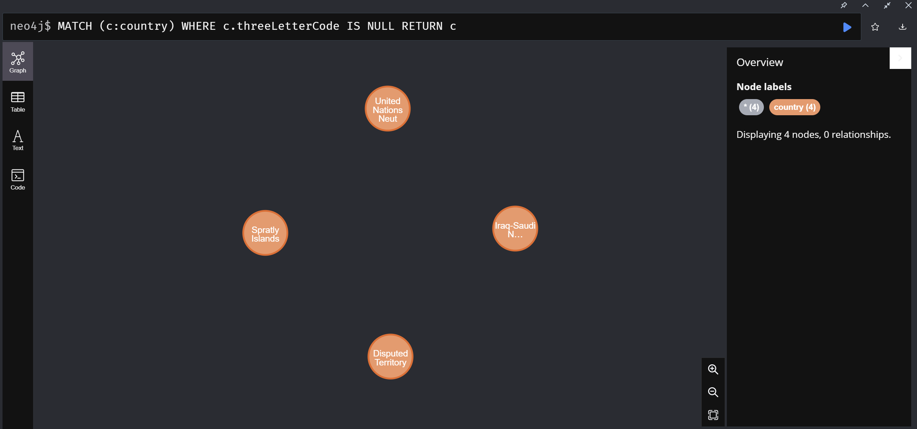

NULL VALUES IN COUNTRY NUMBER BEFORE AND AFTER
NULL VALUES IN THREE LETTER CODE BEFORE AND AFTER

Slide 24
Queries performed to remove NULL value nodes are:
Query 1 (to remove countries):
MATCH (c:country)-[r:PART_OF]->(ct:continent)
WHERE c.avgIncome IS NULL
DELETE r, c
Query 2 (to remove continents):
MATCH (c:continent)
WHERE c.avgIncome IS NULL
DELETE c

Slide 25
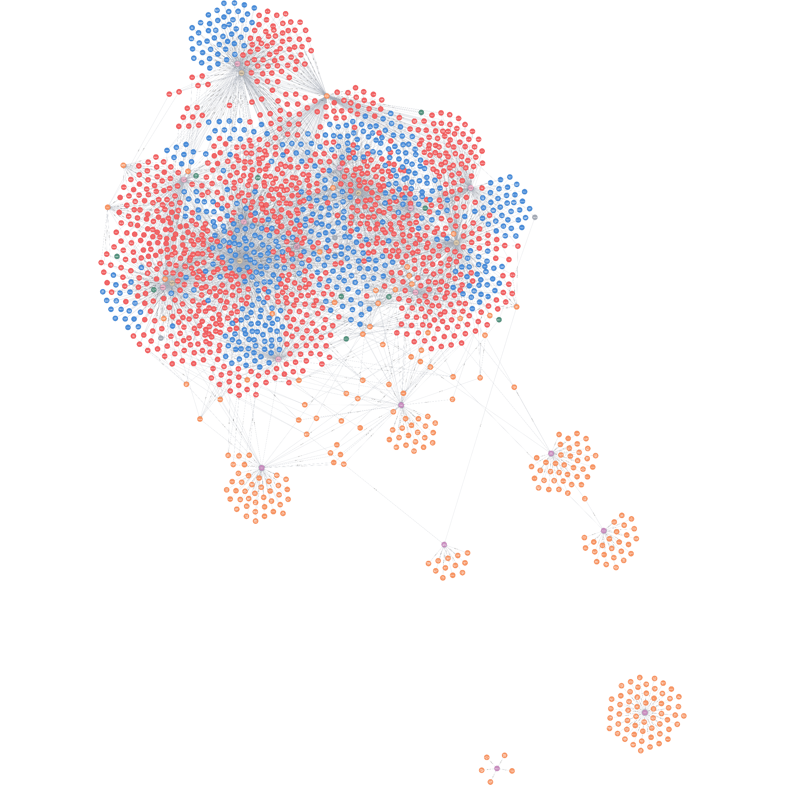
FINAL GRAPH BEFORE REMOVING NULL VALUES

Slide 26
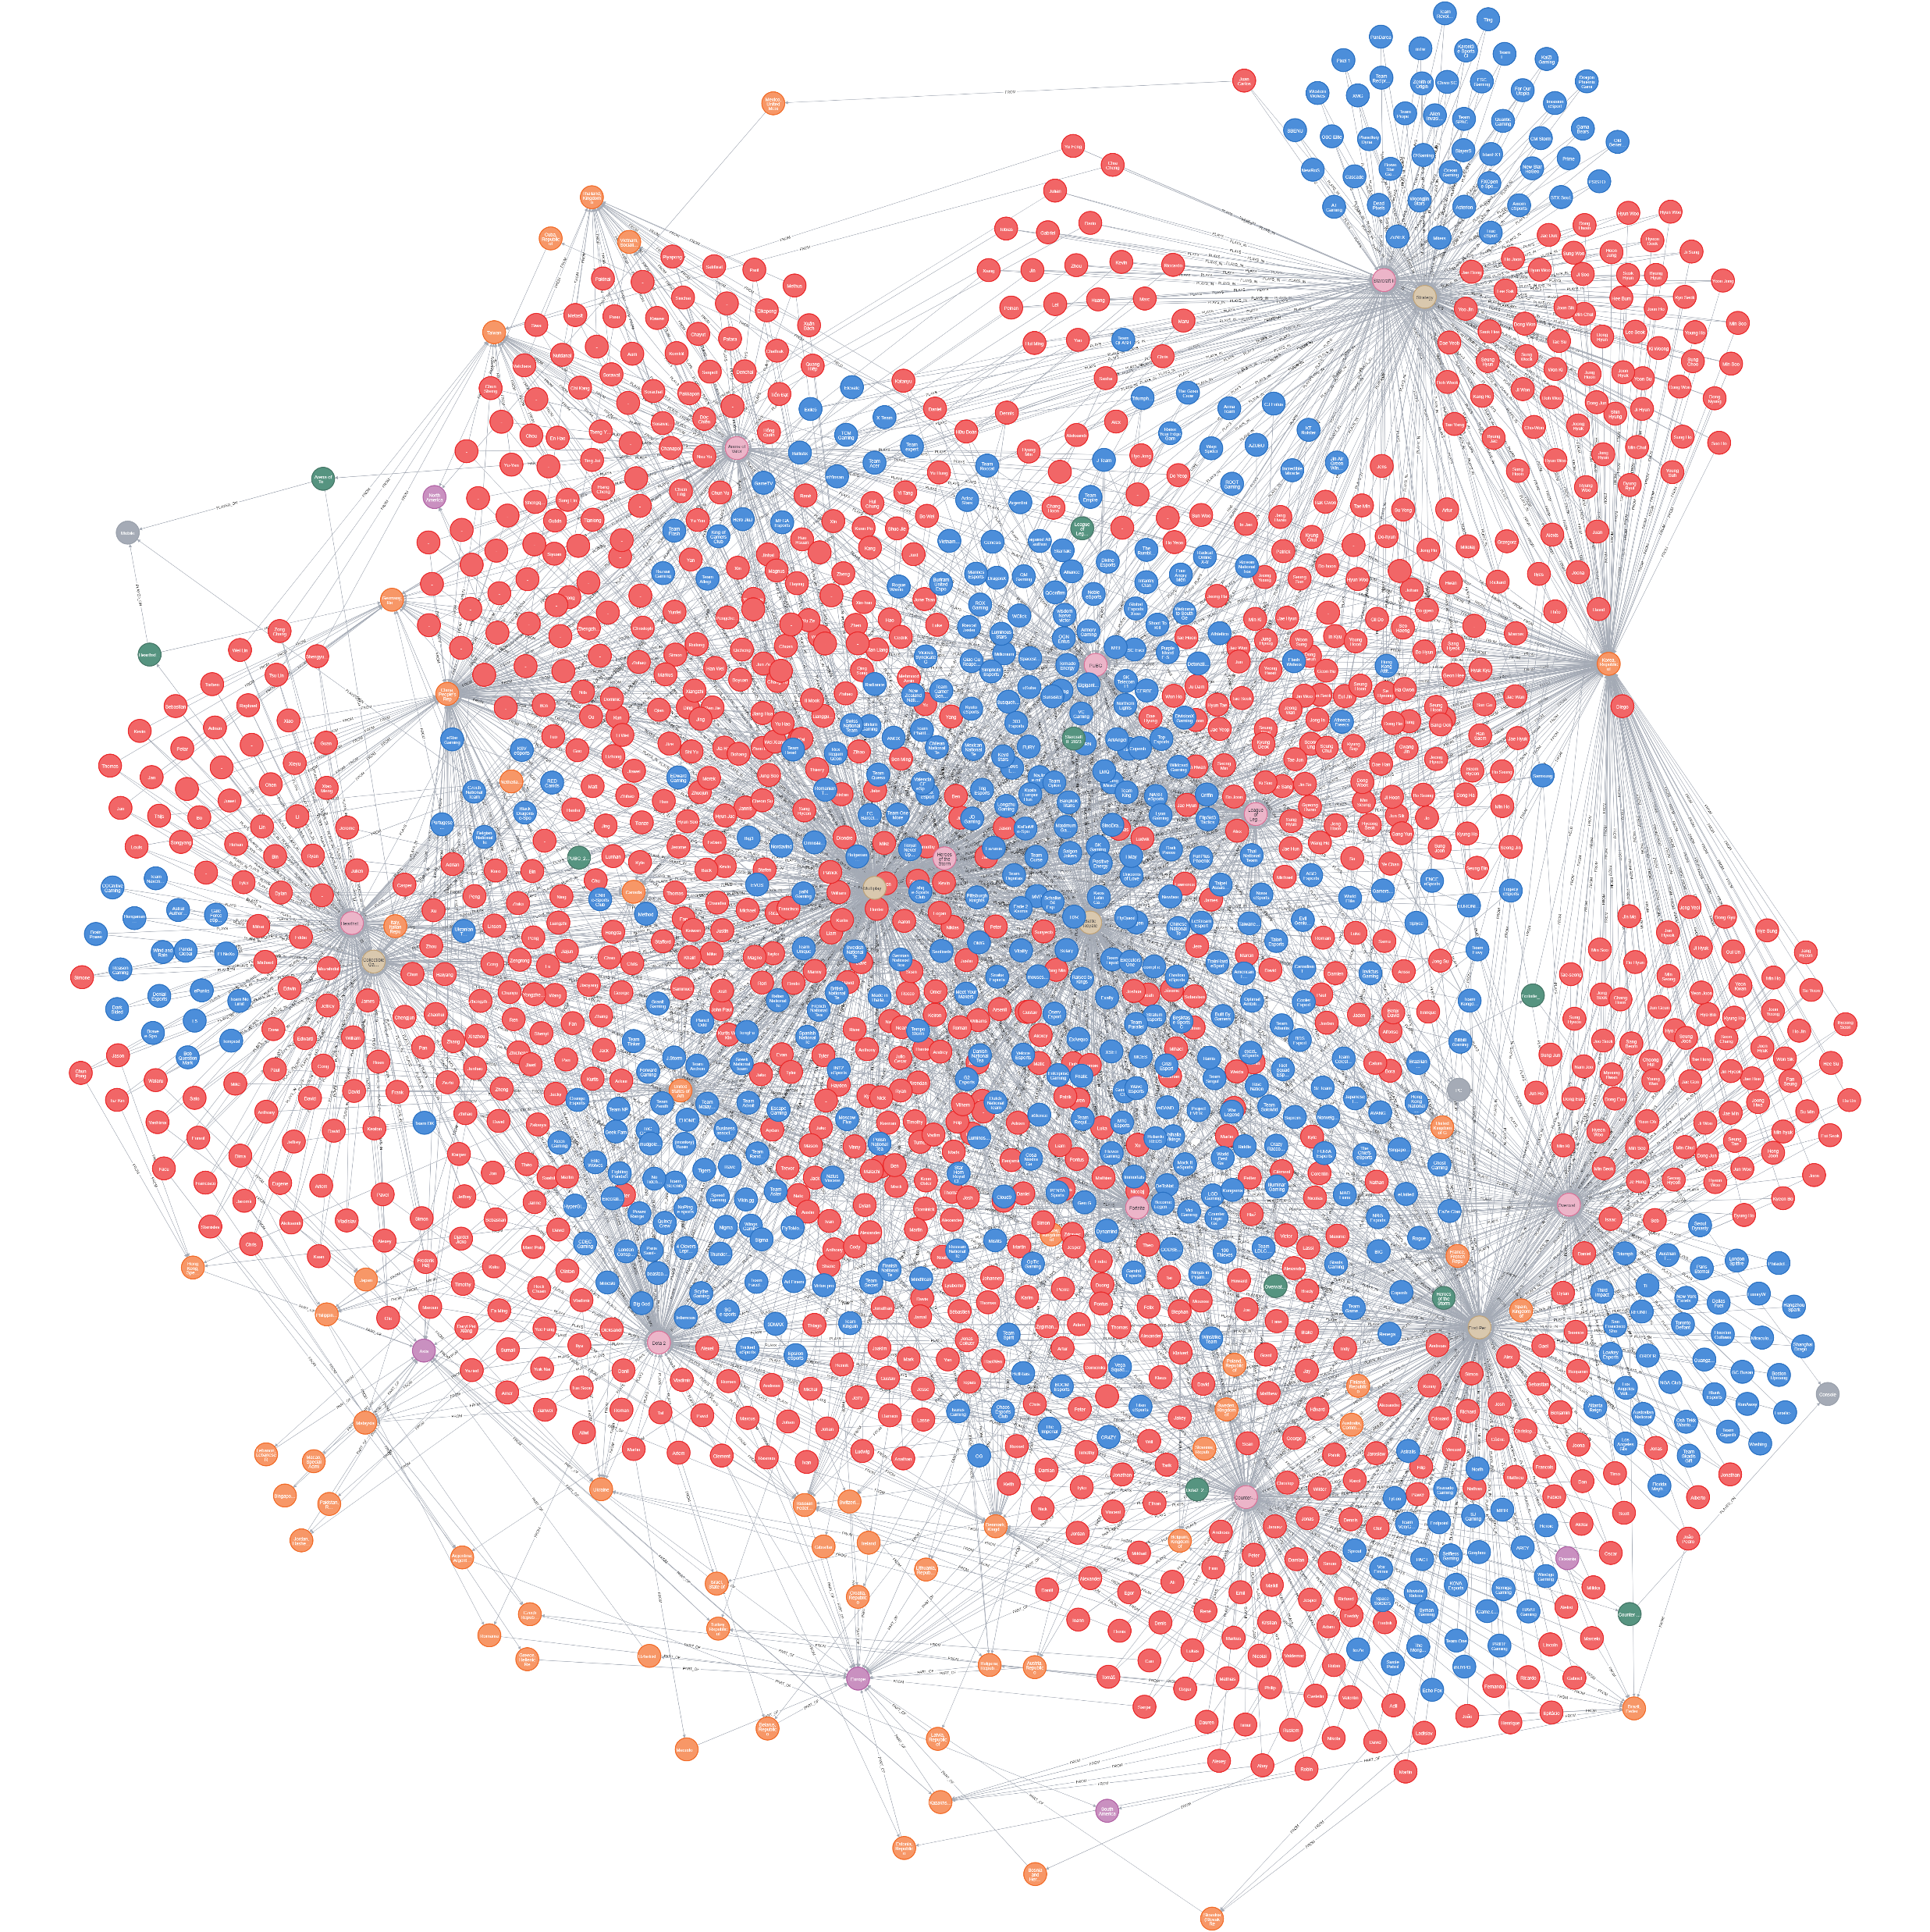
FINAL GRAPH AFTER REMOVING NULL VALUES

Slide 27
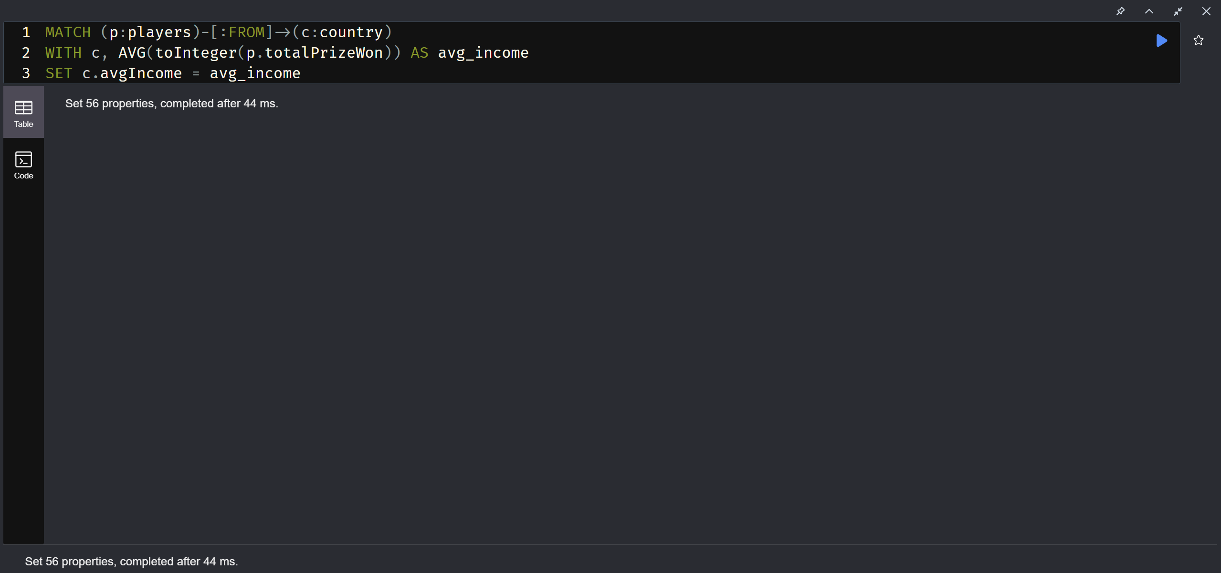
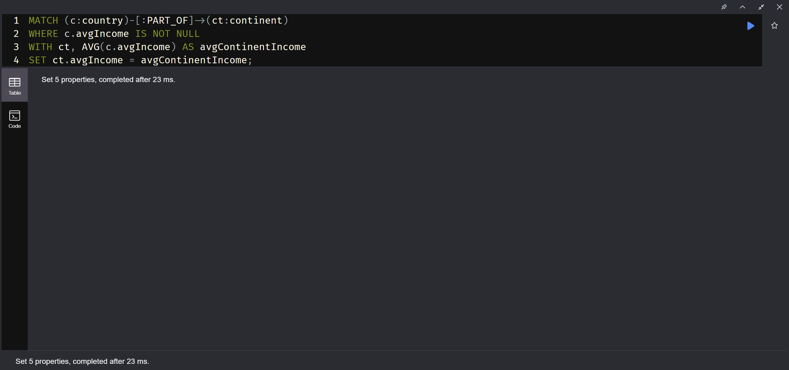
AGGREGATION
1. Aggregation of average income of a players of a country
Use “AVG” to find the average
Code for the aggregation:
MATCH (p:players)-[: FROM]→ (c: country)
WITH C, AVG(toInteger(p.totalPrizeWon)) AS avg_income
SET c.avgIncome = avg_income
2. Aggregation of average income of a country and continent
Use “AVG” to find the average
Code for the aggregation:
MATCH (c:country)-[:PART_OF]→(ct: continent)
WHERE c.avgIncome IS NOT NULL
WITH ct, AVG(c.avgIncome) AS avgContinentIncome
SET ct.avgIncome = avgContinent Income;

Slide 28
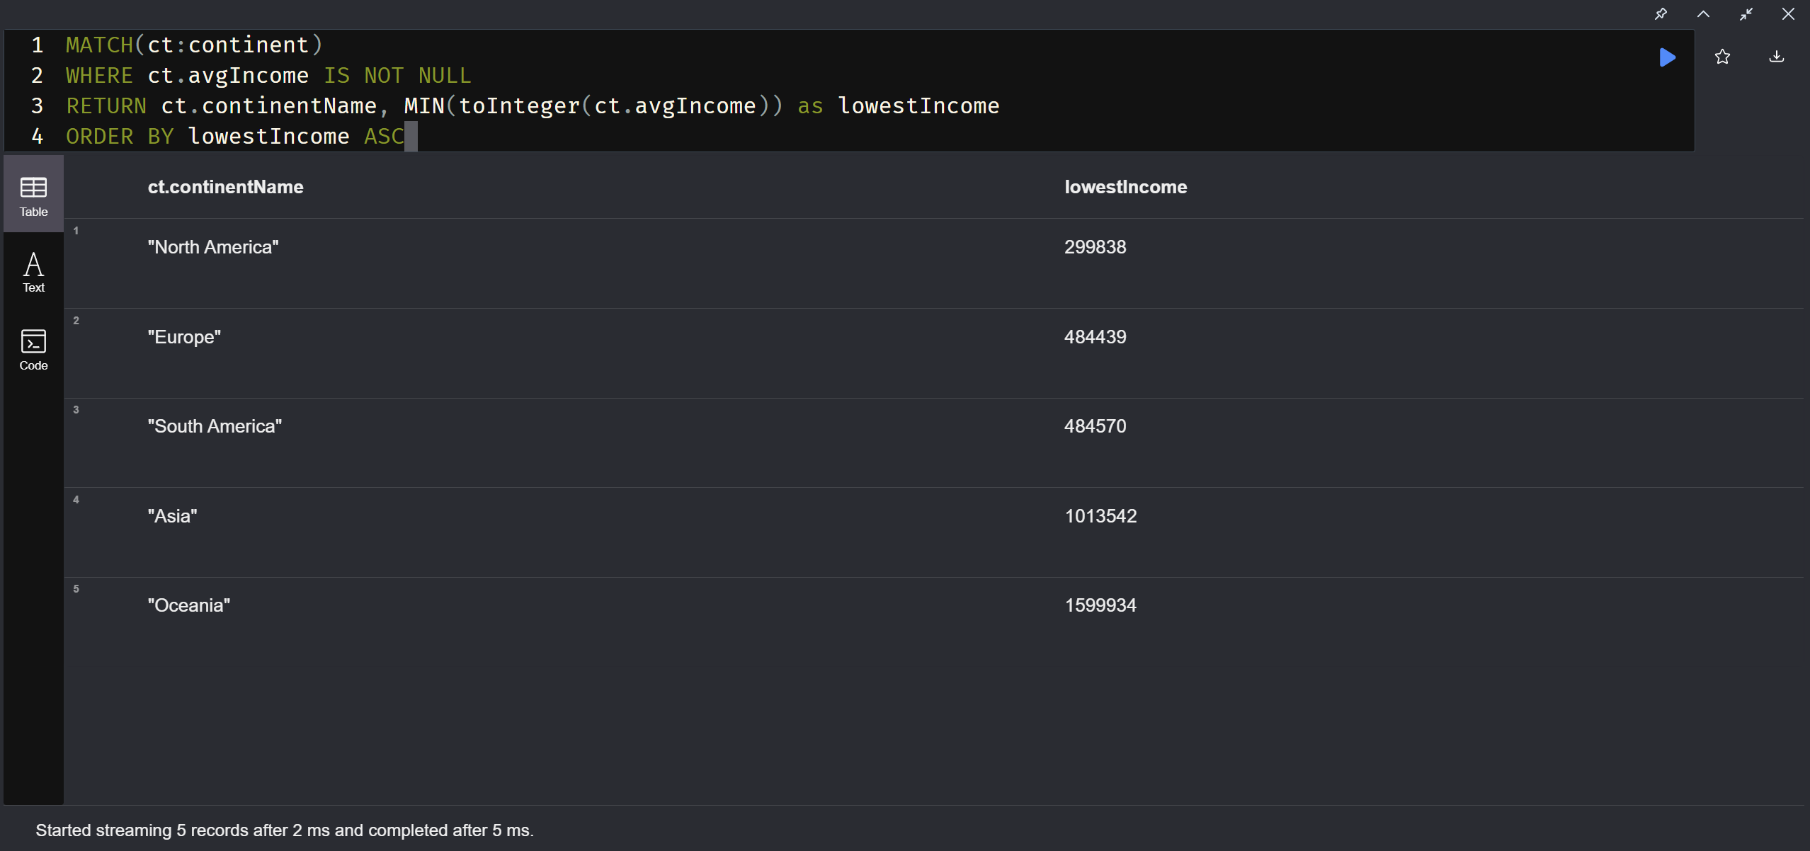
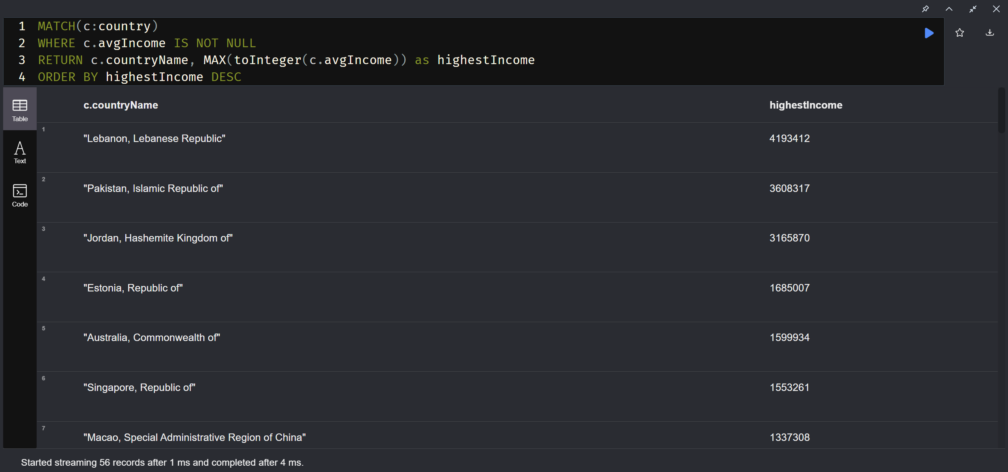
3. Arranging the continents based on their incomes using the “MIN()” function in ascending order:
Code of aggrigaion:
MATCH (ct:continent)
WHERE ct.avgIncome IS NOT NULL
RETURN ct.continentName, MIN(toInteger (ct. avgIncome)) as lowest Income
ORDER BY LowestIncome ASC
4. Arranging the countries based on their incomes using the “Max()” function in descending order:
Code of aggrigaion:
MATCH (c:country)
WHERE c.avgIncome IS NOT NULL
RETURN c.countryName, Max(toInteger (ct. avgIncome)) as highest Income
ORDER BY highestincome DESC

Slide 29
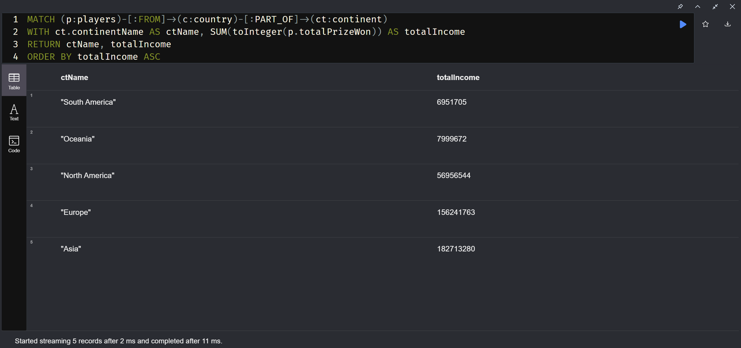
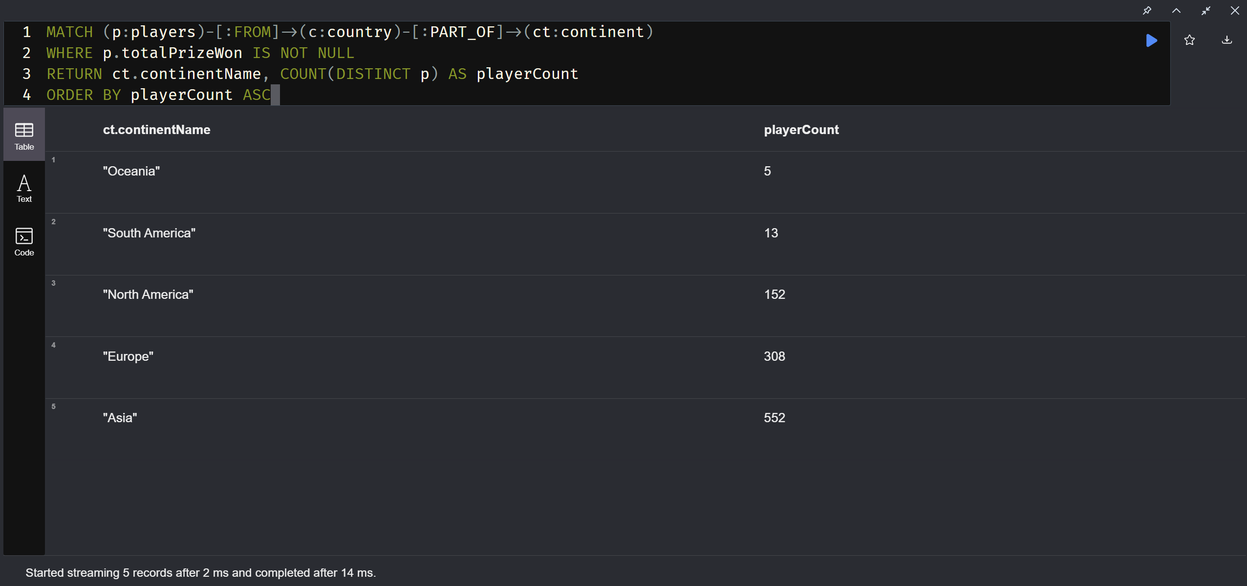
5. Arranging the continents based on their total prizes won in ascending order:
Code of aggregation:
MATCH (p:players)-[:FROM](c: country)-[:PART_OF](ct:continent)
WITH ct.continentName AS ctName, SUM(toInteger (p.totalPrizeWon)) AS totalIncome
RETURN ctName, totalIncome
ORDER BY totalIncome ASC
6. How many players for a continent:
Code of aggregation:
MATCH (p:players)-[:FROM](c: country)-[:PART_OF](ct:continent)
WHERE p.totalPrizeWon IS NOT NULL
RETURN ct.continentName, COUNT(DISTINCT p) AS playerCount
ORDER BY playerCount ASC

Slide 30
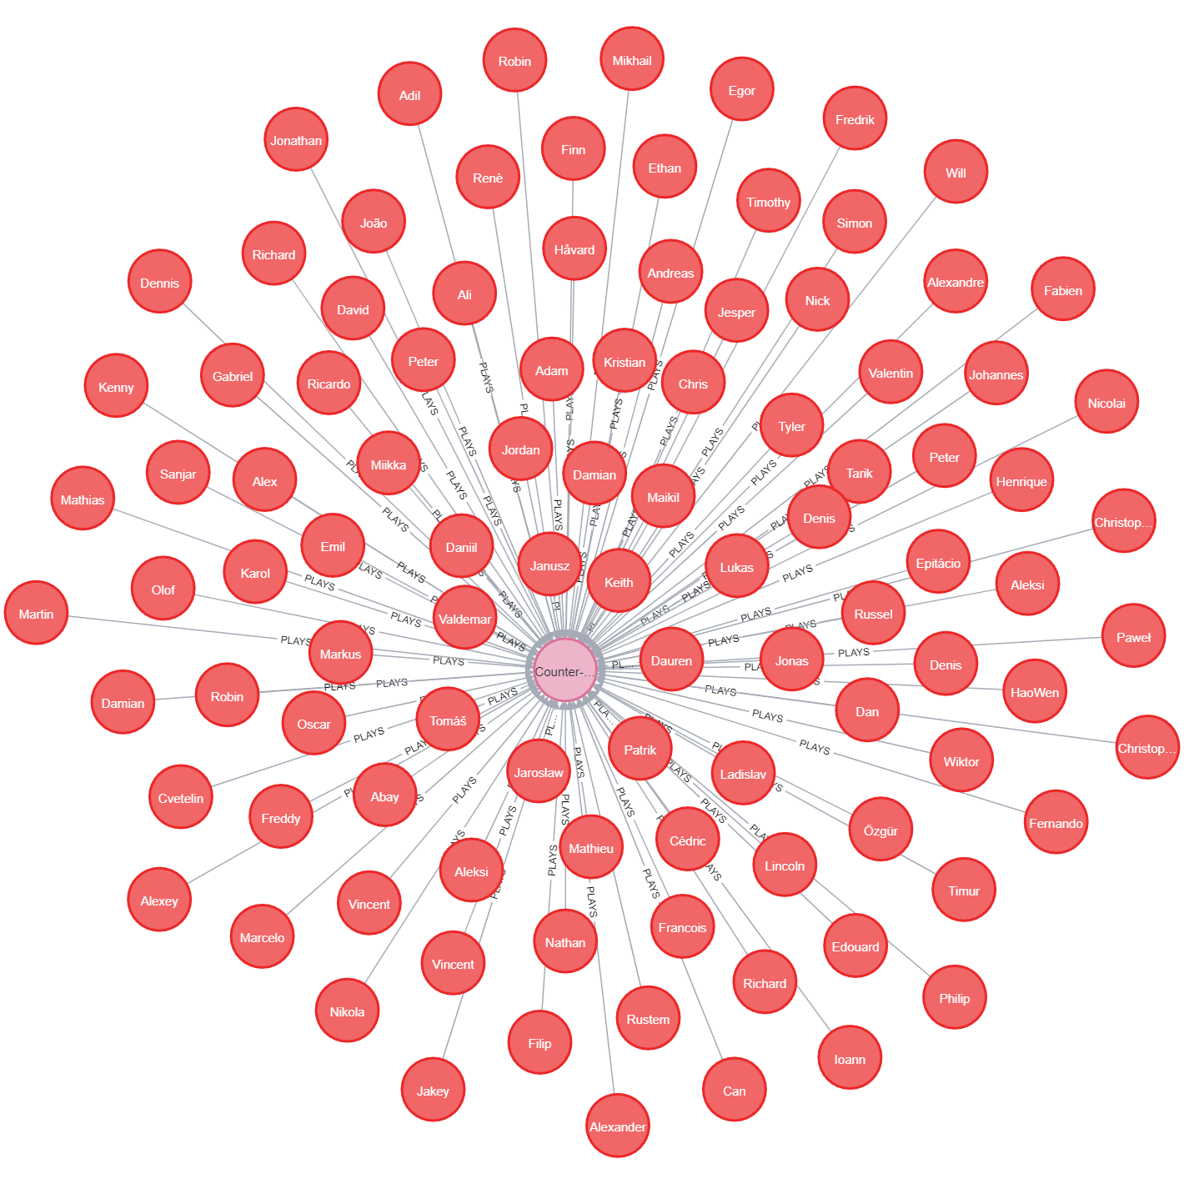
QUERYING THE DATABASE
Get all the players of a specific game called “Counter-Strike: Global Offensive”
Query:
MATCH (p:players)-[:PLAYS]->(g:games {gameName: 'Counter-Strike: Global Offensive'})
RETURN p, g

Slide 31
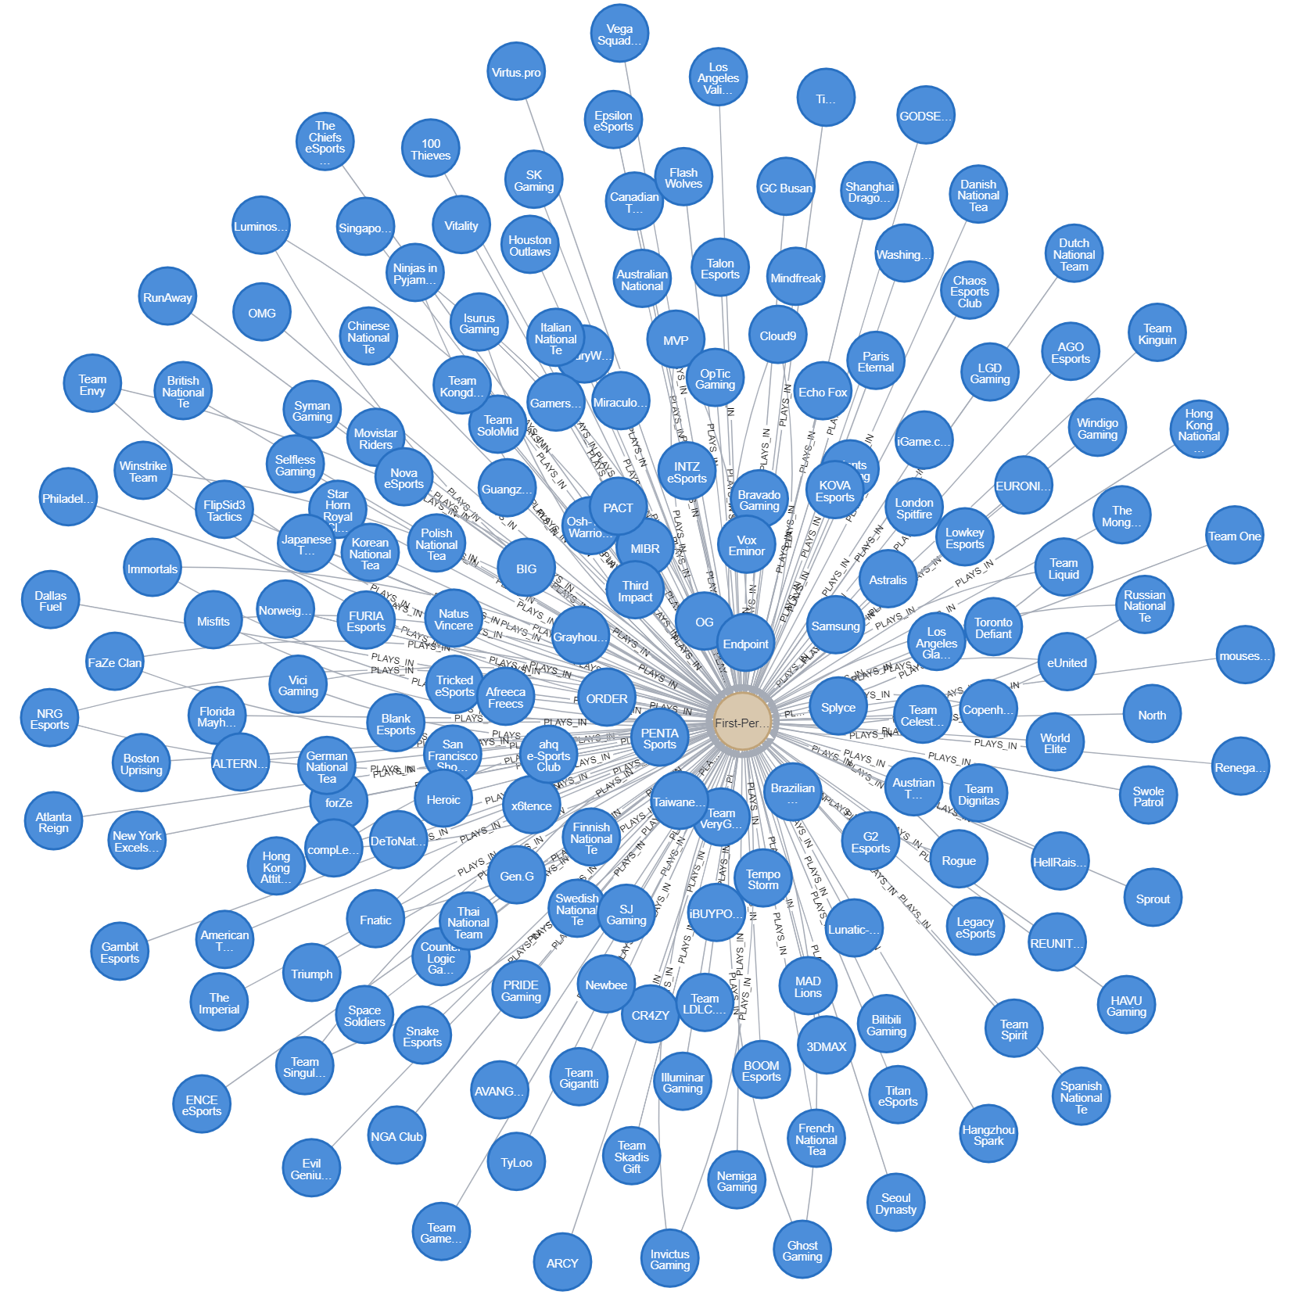
Get all the teams of a specific genre called “First-Person Shooter”
Query:
MATCH (t:teams)-[:PLAYS_IN]->(g:genre {genreName: 'First-Person Shooter'})
RETURN t, g

Slide 32
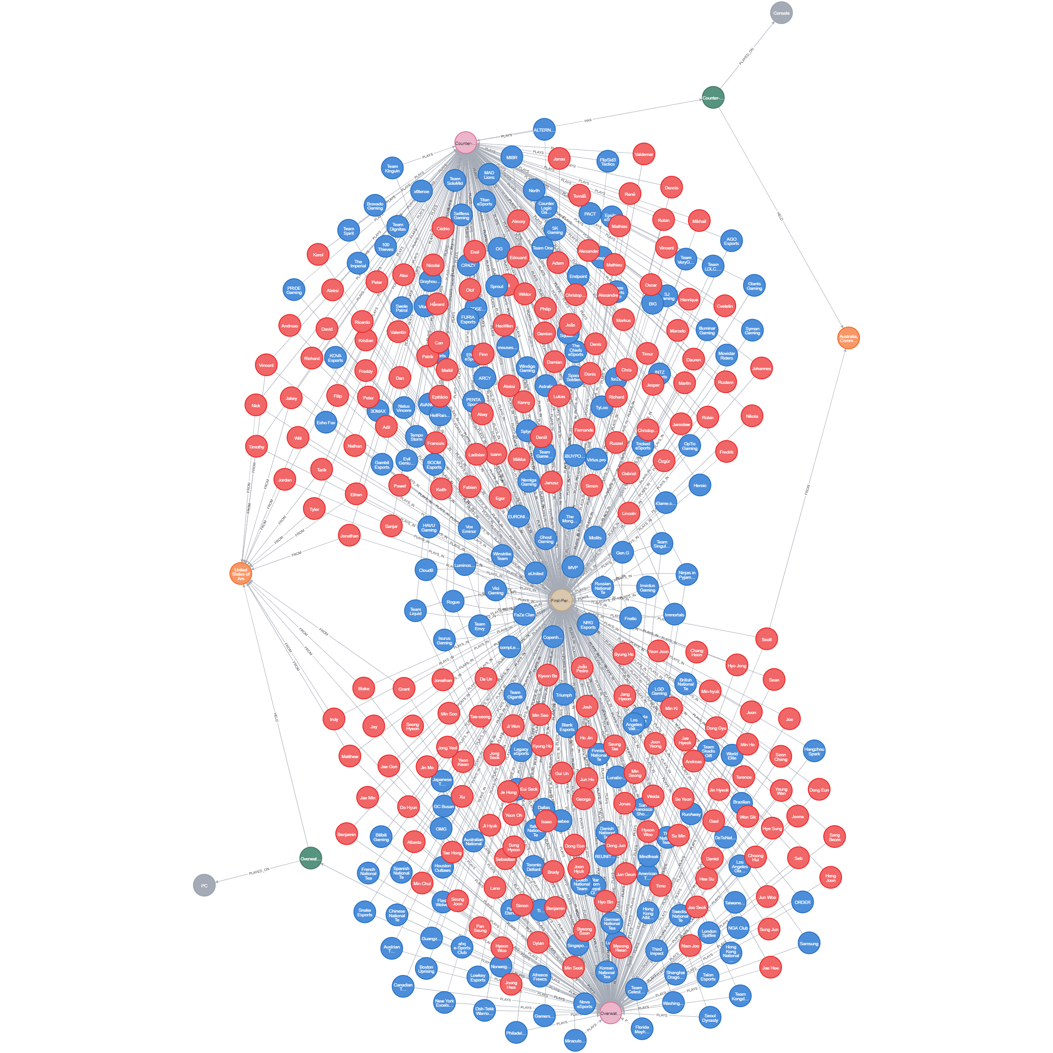
Get all the players, teams, games, tournaments, tournament_platform and tournament_location of a specific genre called “First-Person Shooter”
Query:
MATCH (p:players)-[:PLAYS_IN]->(gen:genre {genreName: 'First-Person Shooter'})<-[:IS]-(g:games)-[:HAS]->(tour:tournaments)-[:PLAYED_ON]->(plat:platform)
MATCH (tour)-[:HELD]->(c:country)
MATCH (g)<-[:PLAYS]-(t:teams)-[:PLAYS_IN]->(gen)
RETURN p, gen, g, tour, plat, c, t

Slide 33
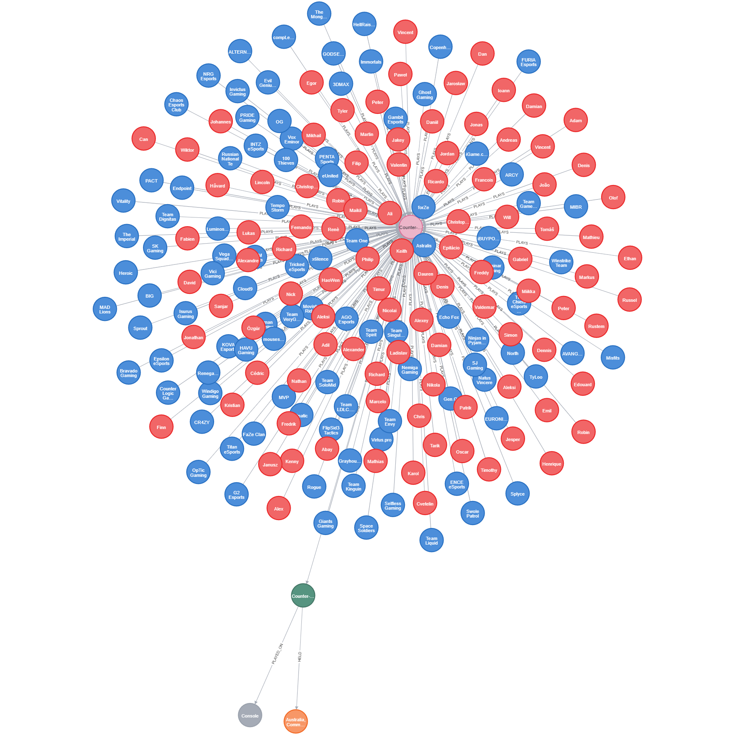
Get all the players, teams, tournaments, tournament_platform and tournament_location for a specific game called “Counter-Strike: Global Offensive”
Query:
MATCH (p:players)-[:PLAYS]->(g:games {gameName: 'Counter-Strike: Global Offensive'})-[:HAS]->(tour:tournaments)-[PLAYED_ON]->(plat:platform)
MATCH (tour)-[:HELD]->(c:country)
MATCH (t:teams)-[:PLAYS]->(g)
RETURN p, g, tour, plat, c, t

Slide 34
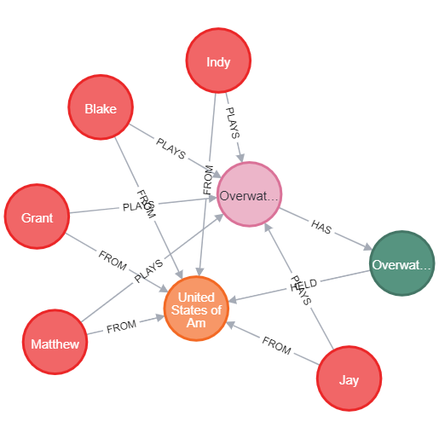
Get all the players who play games whose tournaments are going to held in a specific country called “United States of America”
Query:
MATCH (c:country {countryName: 'United States of America'})<-[:FROM]-(p:players)-[:PLAYS]->(g:games)
MATCH (c)<-[:HELD]-(t:tournaments)<-[:HAS]-(g)
RETURN c, p, t, g

Slide 35

Conclusion
In conclusion, our project successfully addressed the challenges of representing and analyzing e-sports data by leveraging a graph database, specifically Neo4j. We developed a systematic approach to construct and manage the graph database schema, effectively loaded data from diverse sources, and established meaningful relationships between entities. This enabled us to gain valuable insights and facilitate exploration of the interconnected nature of e-sports data. The use of a graph database proved to be a powerful and efficient solution for extracting insights from the complex e-sports data landscape, benefiting various organizations , stakeholders in the industry, also normal person who are fascinated about Esports.

Slide 36

THANK YOU

